Slide 1
Module 1- Introduction to AI, Gen AI Essentials

Slide 2
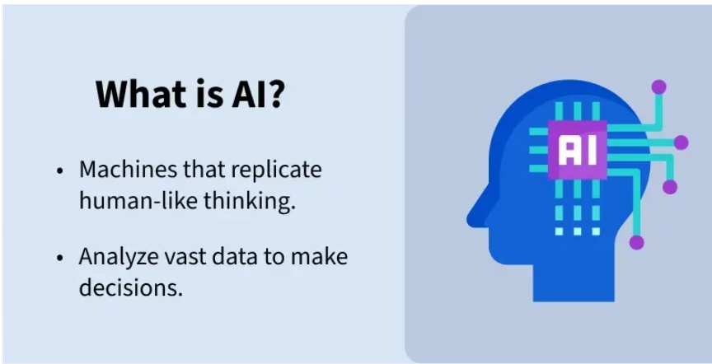
What is AI and Key Concepts
What is AI and Types of AI
Artificial Intelligence (AI) is a branch of computer science that focuses on building machines or software that can perform tasks that normally require human intelligence.
These tasks include:
Learning from data
Understanding language
Recognizing images and speech
Making decisions
Solving problems
For example, an AI model might predict weather patterns, identify objects in photos, or generate text.
AI is the ability of a computer or machine to mimic human intelligence.

Slide 3
Examples of AI
Voice assistants (Alexa, Google Assistant)
Recommendation systems (YouTube, Netflix)
Self-driving cars
Chatbots
Face recognition systems

Slide 4
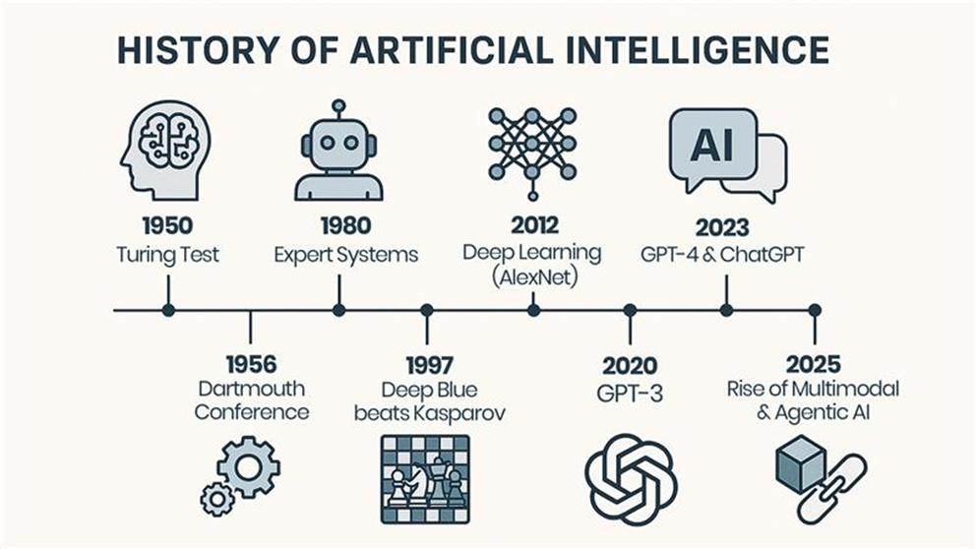
History of AI

Slide 5
History of AI
1950 — Turing Test
Figure: Human brain icon
In 1950, British mathematician Alan Turing proposed a test for machine intelligence.
The basic question was:
Can a machine behave in a way that is indistinguishable from a human in conversation?
The idea became known as the Turing Test.
Why is it important?
It was one of the earliest influential discussions about whether machines could demonstrate intelligent behavior.

Slide 6
History of AI
2. 1956 — Dartmouth Conference
Figure: Gear icons
This is generally considered the birth of AI as a formal research field.
At the Dartmouth workshop, researchers proposed studying whether aspects of human intelligence could be described precisely enough for machines to simulate them.
The term Artificial Intelligence is closely associated with this event, particularly with John McCarthy.
This established AI as a distinct academic field.

Slide 7
History of AI
3. 1980 — Expert Systems
Figure: Robot
During the 1970s and especially the 1980s, expert systems became an important AI approach.
Instead of learning automatically from huge datasets, these systems used rules created from human expert knowledge.
For example:
IF customer has fever
AND customer has cough
THEN suggest medical evaluation
Applications
Expert systems were developed for areas such as:
Medical diagnosis
Finance
Manufacturing
Limitation
They required humans to manually create and maintain large numbers of rules.

Slide 8
History of AI
4. 1997 — Deep Blue Beats Kasparov
Figure: Chess board
In 1997, IBM's Deep Blue defeated world chess champion Garry Kasparov in a six-game match.
This was a major milestone in AI.
Deep Blue demonstrated that computers could perform extremely sophisticated decision-making in a complex game.
Important point for students
Deep Blue was not a Generative AI system.
It primarily used specialized chess search and evaluation techniques rather than today's large neural-network-based language models.

Slide 9
History of AI
5. 2012 — Deep Learning / AlexNet
Figure: Neural-network nodes
This is one of the most important steps toward today's AI.
In 2012, AlexNet demonstrated the power of deep neural networks for image recognition.
The combination of:
Large datasets
More powerful GPUs
Improved neural-network techniques
caused rapid progress in Deep Learning.
Deep learning subsequently became extremely important in:
Computer vision
Speech recognition
Natural language processing
Recommendation systems
Autonomous systems

Slide 10
History of AI
6. 2020 — GPT-3
Figure: OpenAI logo
GPT-3 was a major milestone in the development of Large Language Models (LLMs).
GPT-3 demonstrated that a very large language model could perform many different language tasks from natural-language instructions and examples.
It could generate:
Text
Stories
Summaries
Answers
Code
Translations
Important transition
This represents a movement from:
AI that predicts/classifies → AI that generates content
That is the beginning of the modern Generative AI era.

Slide 11
History of AI
7. 2023 — GPT-4 & ChatGPT
Figure: AI/chat icon
This part of the diagram represents the rapid mainstream adoption of Generative AI.
A small clarification is useful when teaching this:
ChatGPT was launched publicly in November 2022, while GPT-4 was introduced in March 2023.
ChatGPT made interaction with an LLM extremely accessible.
Instead of writing computer instructions in a programming language, users could simply write:
"Explain this concept."
or
"Create a Selenium Java test using Page Object Model."
The AI could respond in natural language and generate useful content.

Slide 12
History of AI
8. 2025 — Multimodal & Agentic AI
Figure: Cube + connected nodes
The final part of the diagram represents the transition toward AI systems that can work across multiple types of information and perform multi-step tasks.
Multimodal AI
Instead of working only with text, AI can work with combinations of:
Text
Images
Audio
Video
Code

Slide 13
Types of AI
Types of Artificial Intelligence
Based on Capabilities
Based on Functionality

Slide 14
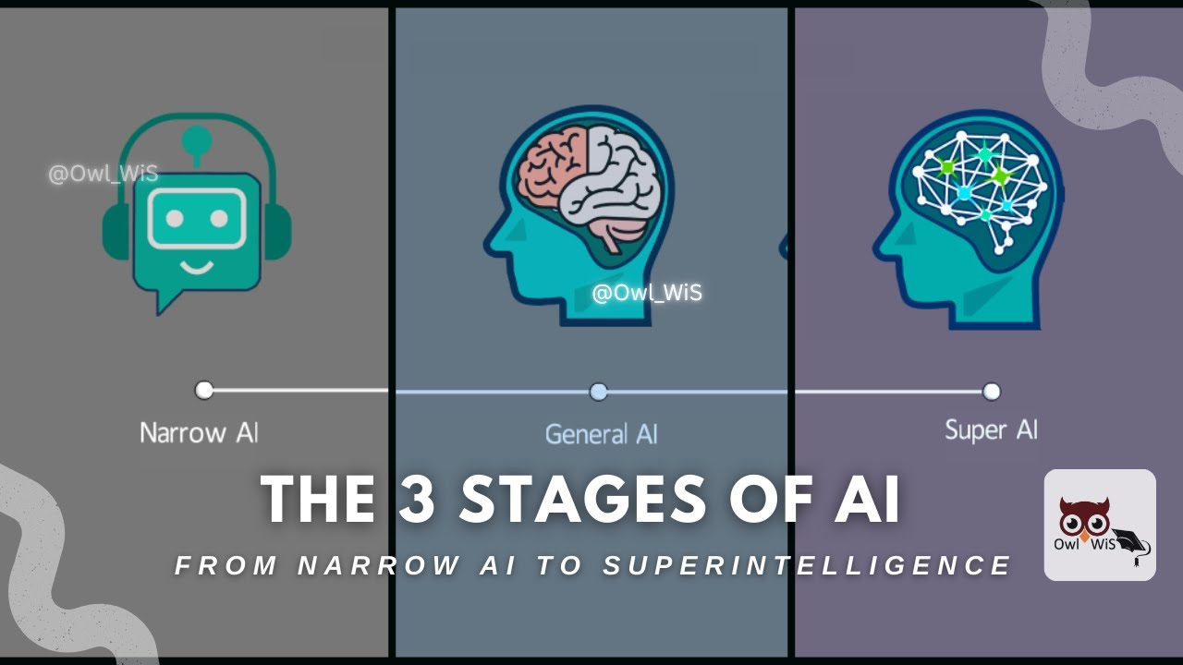
Stages of AI

Slide 15
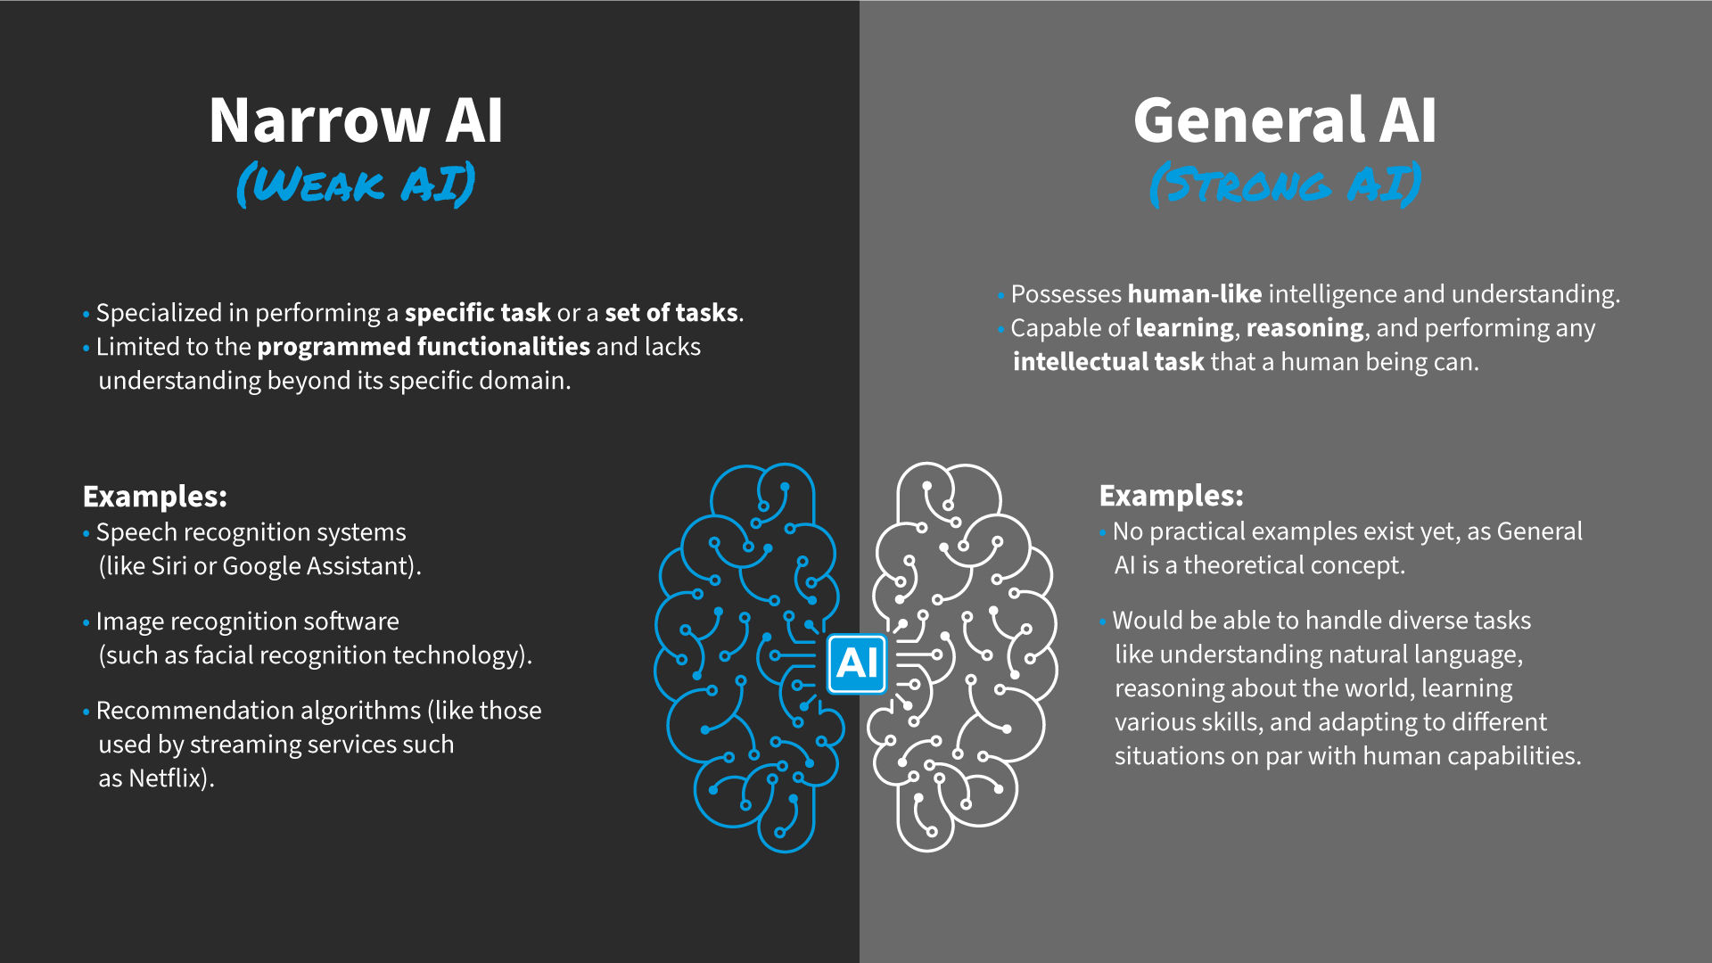
Types of AI - Based on Capabilities
https://www.ibm.com/think/topics/artificial-intelligence-types

Slide 16
Types of AI - Based on Capabilities - Narrow AI (Weak AI)
Narrow AI is designed to perform a specific task only.
Key Characteristics
Specialized in one domain
Cannot perform tasks outside its training
Most AI systems today fall into this category
Examples
Google Assistant
Siri
ChatGPT
Recommendation systems (Netflix, Amazon)
Explanation
Even though systems like ChatGPT feel intelligent, they do not possess true understanding or general reasoning across all domains.

Slide 17
Types of AI - Based on Capabilities - General AI (Strong AI / AGI)
General AI refers to machines that can perform any intellectual task that a human can do.
Key Characteristics
Human-level intelligence
Can reason, learn, and adapt across multiple domains
Can transfer knowledge between tasks
Current Status
Not yet achieved
Still a major research goal
Example (Hypothetical)
A robot that can:
Learn math
Drive a car
Write code
Understand emotions

Slide 18
Types of AI - Based on Capabilities - Super AI
Super AI is a level beyond human intelligence.
Key Characteristics
Surpasses human intelligence in all aspects:
Creativity
Decision-making
Emotional intelligence
Can improve itself (self-evolving systems)
Current Status
Purely theoretical
Often discussed in future AI and ethics debates

Slide 19
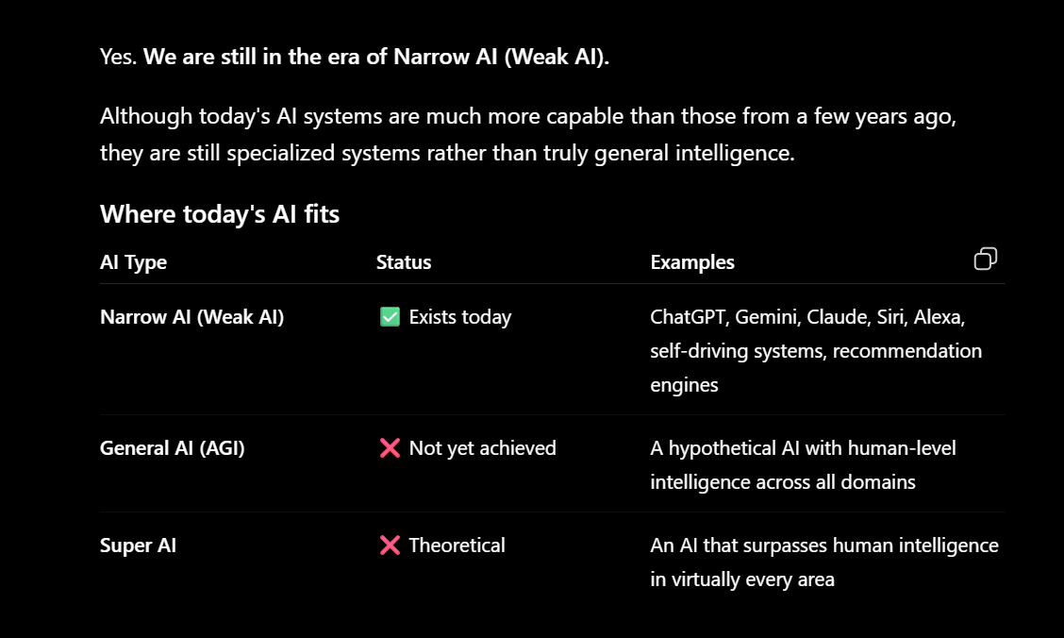
Types of AI - Based on Capabilities

Slide 20
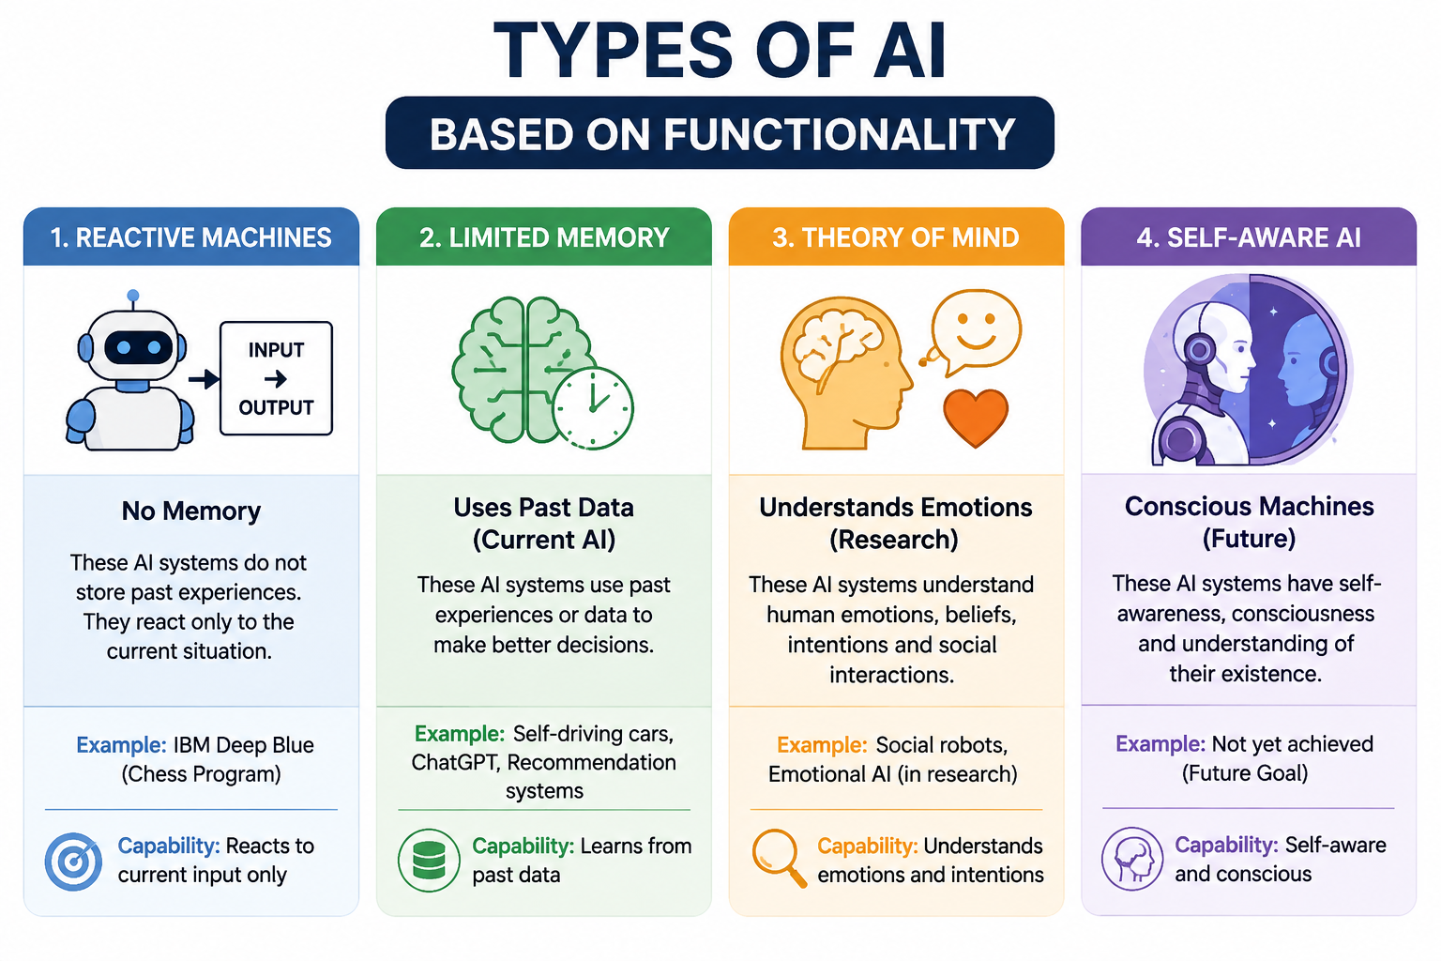
Types of AI Based on Functionality

Slide 21
Types of AI Based on Functionality - Reactive Machines
These AI systems do not have memory and only respond to current inputs.
Key Characteristics
No learning from past experiences
Works only on present data
Very basic AI
Example
IBM Deep Blue: IBM’s chess-playing supercomputer AI beat chess grandmaster Garry Kasparov in the late 1990s by analysing the pieces on the board and predicting the probable outcomes of each move.
The Netflix Recommendation Engine: Netflix’s viewing recommendations are powered by models that process data sets collected from viewing history to provide customers with content they’re most likely to enjoy.

Slide 22
Types of AI Based on Functionality - Limited Memory
These systems can use past data to improve decisions. Limited Memory AI can use past- and present-moment data to decide on a course of action most likely to help achieve a desired outcome.
Key Characteristics
Learns from historical data
Temporary memory
Most modern AI systems belong here
recall past events
Examples
Generative AI: Generative AI tools such as ChatGPT, Bard and DeepAI rely on limited memory AI capabilities to predict the next word, phrase or visual element within the content it’s generating.
Virtual assistants and chatbots: Siri, Alexa, Google Assistant, Cortana and IBM Watson Assistant combine natural language processing (NLP) and Limited Memory AI to understand questions and requests, take appropriate actions and compose responses.
Self-driving cars: Autonomous vehicles use Limited Memory AI to understand the world around them in real-time and make informed decisions on when to apply speed, brake, make a turn, etc.

Slide 23
Types of AI Based on Functionality - Theory of Mind AI
Theory of Mind AI is a functional class of AI that falls underneath the General AI.
This type of AI can understand emotions, beliefs, and intentions of others.
Key Characteristics
Understands human emotions
Can interact socially
Adapts behavior based on others
Current Status
Still in research phase
Not fully developed

Slide 24
Types of AI Based on Functionality - Self-Aware AI
Self-Aware AI is a kind of functional AI class for applications that would possess super AI capabilities. Like theory of mind AI, Self-Aware AI is strictly theoretical.
Key Characteristics
Ability to analyse voices, images and other kinds of data to recognize, simulate, monitor and respond appropriately to humans on an emotional level
Current Status
To date, Emotion AI is unable to understand and respond to human feelings.

Slide 25
Types of AI
Based on Capabilities
Narrow AI → Task-specific (existing)
General AI → Human-level (future)
Super AI → Beyond human (theoretical)
Based on Functionality
Reactive Machines → No memory
Limited Memory → Uses past data (current AI)
Theory of Mind → Understands emotions (research)
Self-Aware AI → Conscious machines (future)

Slide 26
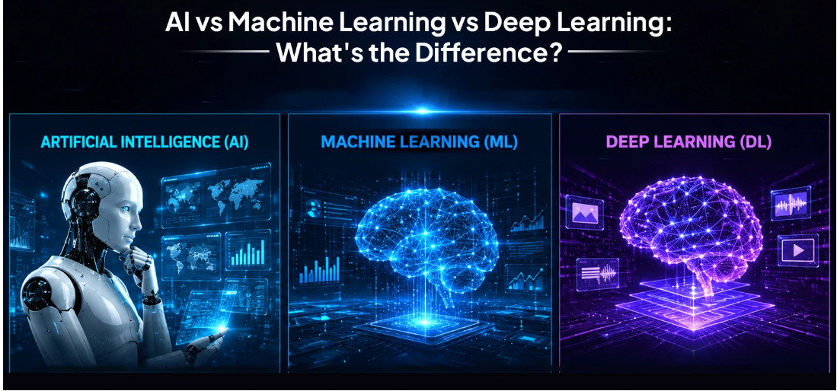
AI Vs ML Vs DL Vs Generative AI Vs Agentic AI
AI is the broadest concept → ML is a subset of AI → DL is a subset of ML.

Slide 27
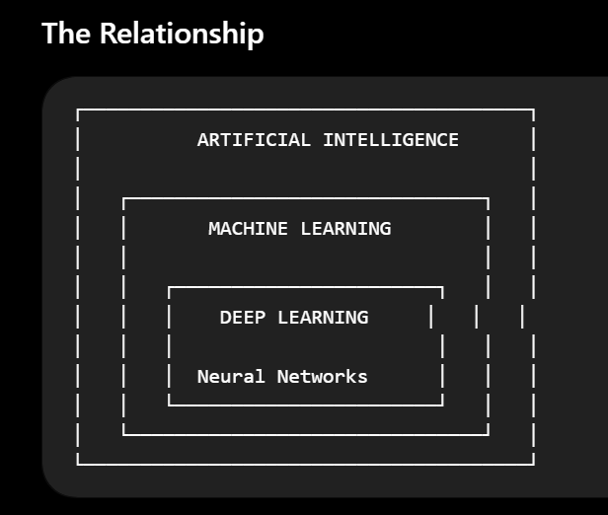
AI Vs ML Vs DL Vs Generative AI Vs Agentic AI
AI is the broadest concept → ML is a subset of AI → DL is a subset of ML.

Slide 28
AI Vs ML Vs DL Vs Generative AI Vs Agentic AI
What is Artificial Intelligence?
Artificial Intelligence is the broader field of creating computer systems that can perform tasks that normally require human intelligence.
These tasks can include:
Reasoning
Learning
Problem solving
Planning
Decision making
Understanding language
Recognizing images
Understanding speech
Generating content

Slide 29
AI Vs ML Vs DL Vs Generative AI Vs Agentic AI
Example
Imagine a customer-support chatbot.
A customer asks:
"My payment failed. What should I do?“
An AI system might:
Understand the question.
Identify the customer's problem.
Retrieve relevant information.
Decide what response is appropriate.
Generate an answer.
That entire capability falls under AI.

Slide 30
AI Vs ML Vs DL Vs Generative AI Vs Agentic AI
What is Machine Learning?
Machine Learning is a subset of AI where computers learn patterns from data and use those patterns to make predictions or decisions.
Traditional programming looks like:
Rules + Data
↓
Program
↓
Output
The programmer does not necessarily specify every rule manually.
Instead, the system learns patterns from examples.
Machine Learning works more like:
Data + Examples
↓
ML Algorithm
↓
Training
↓
Model
↓
New Data
↓
Prediction

Slide 31
AI Vs ML Vs DL Vs Generative AI Vs Agentic AI
Simple Machine Learning Example
Suppose we want to predict whether an email is Spam or Not Spam.
We provide thousands of examples:
The ML algorithm looks for patterns.
It might discover that certain combinations of words, links, sender information, etc. are associated with spam.
Then a new email arrives:
"Congratulations! Claim your free prize now!"
The trained model predicts:
Spam
Email | Label
"Congratulations! You won $1 million" | Spam
"Meeting scheduled at 10 AM" | Not Spam
"Claim your free prize" | Spam
"Please review the project document" | Not Spam

Slide 32
AI Vs ML Vs DL Vs Generative AI Vs Agentic AI
What is Deep Learning?
Deep Learning is a specialized branch of Machine Learning that uses neural networks with multiple layers to learn complex patterns from large amounts of data.
The key technology is the Artificial Neural Network.
A simplified neural network looks like:
Input Layer Hidden Layers Output
Image ┌───────────────┐
│ │ │
├────────►│ Neural Network├──────► Cat
│ │ │
│ └───────────────┘
│
└────────────────────────────────► Dog

Slide 33
AI Vs ML Vs DL Vs Generative AI Vs Agentic AI
Why Do We Need Deep Learning?
Traditional ML often requires humans to identify useful features.
For example, suppose we want to recognize cats in images.
A traditional approach might require engineers to identify features such as:
Ear shape
Eye shape
Fur patterns
Face shape
Body structure
Deep Learning can learn useful representations automatically from the raw image data.

Slide 34
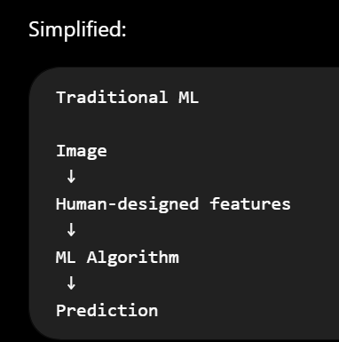
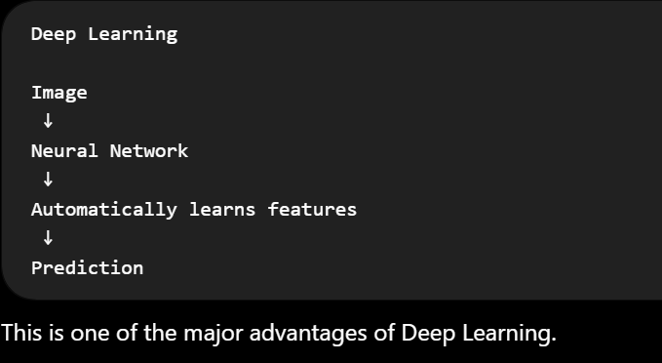
AI Vs ML Vs DL Vs Generative AI Vs Agentic AI

Slide 35
AI Vs ML Vs DL Vs Generative AI Vs Agentic AI
Real-World Example
Let's use self-driving cars.
AI
The overall goal:
Build a vehicle that can perceive its environment and make driving decisions.
AI covers the overall intelligent behaviour.
ML
The vehicle can use Machine Learning to learn patterns from driving data.
For example:
Driving Data
↓
ML Model
↓
Prediction
DL
Deep Learning can be used for difficult perception tasks such as:
Detecting pedestrians
Recognizing traffic signs
Detecting vehicles
Understanding road scenes
Processing camera images

Slide 36
AI Vs ML Vs DL Vs Generative AI Vs Agentic AI
Retail and e-commerce:
AI: round-the-clock support chatbots
ML: "customers also bought" recommendation engines
DL: visual search, where a photo upload returns matching products
Banking and finance:
AI: automating straightforward decisions like standard loan approvals
ML: scoring creditworthiness, flagging unusual transactions
DL: advanced fraud detection across huge transaction volumes
Healthcare:
AI: clinical decision-support tools
ML: predicting patient risk from structured medical records
DL: analysing X-rays and scans to catch anomalies humans might miss

Slide 37
Popular myths about AI
Myth | Reality
1. AI thinks exactly like humans | AI processes patterns in data using mathematical models. It does not think or experience the world exactly like a human.
2. AI is always correct | AI can produce incorrect, incomplete, or misleading answers. This is especially important with Generative AI and LLMs.
3. AI understands everything | AI can process and generate information, but its "understanding" is fundamentally different from human understanding.
4. AI will replace all humans | AI can automate many tasks, but many jobs involve judgment, creativity, communication, responsibility, and physical skills that still require people. AI is more likely to change many jobs and workflows than simply eliminate all human work.
5. More data always makes AI better | Data quality, relevance, diversity, labeling, and bias matter. Poor-quality data can produce poor results.
6. AI is the same as Machine Learning | AI is the broader field. Machine Learning is one approach used to build AI systems.
7. Generative AI creates information from nothing | Generative AI learns patterns from training data and generates new outputs based on those learned patterns and the current input.
8. AI has human-like common sense | AI can perform impressive reasoning tasks but can still make surprisingly basic mistakes or misunderstand context.
9. AI is unbiased | AI systems can reproduce or amplify biases present in training data, model design, or deployment.

Slide 38
Popular myths about AI
10. AI automatically knows the latest information | An AI model does not necessarily have real-time knowledge. Current information may require access to updated data or tools.
11. AI can completely replace human decision-making | In high-impact situations, human oversight, validation, accountability, and domain expertise remain important.
12. AI and robots are the same thing | AI is software/intelligence; robotics is concerned with machines that interact with the physical world. Robots can use AI, but AI does not require a robot.
13. A bigger AI model is always better | Larger models can have advantages, but performance also depends on architecture, training data, tools, prompting, evaluation, cost, latency, and the specific task.
14. AI learns every time you talk to it | A model's behavior during a conversation does not necessarily mean its underlying model is being permanently retrained from that conversation.
15. If AI gives a confident answer, it must be true | Confidence in wording is not proof of correctness. AI output should be verified when accuracy matters.

Slide 39
Introduction to data in AI
Data is the foundation of Artificial Intelligence. AI systems learn patterns from data and use those patterns to make predictions, classifications, recommendations, or generate content.
A simple way to understand the relationship is:
Data → Learning → Model → Prediction/Generation
Data refers to raw facts, figures, or information that can be processed and analysed to extract meaningful insights.
In data science and computing, data is categorised into different types based on its structure and nature.
Understanding its type helps in selecting appropriate analysis and processing methods.

Slide 40
Introduction to data in AI
What is Data?
Data is a collection of facts, observations, measurements, or information that can be processed by a computer.
Examples:
Customer names and transactions
Images
Videos
Audio
Text
Sensor readings
Test execution results
Application logs
Financial transactions
Medical records

Slide 41
Introduction to data in AI
For example, an e-commerce company might have:
This data can be used by AI to identify patterns and make predictions.
Customer | Product | Price | Quantity | Purchase
C001 | Laptop | ₹60,000 | 1 | Yes
C002 | Phone | ₹25,000 | 2 | Yes
C003 | Laptop | ₹60,000 | 0 | No

Slide 42
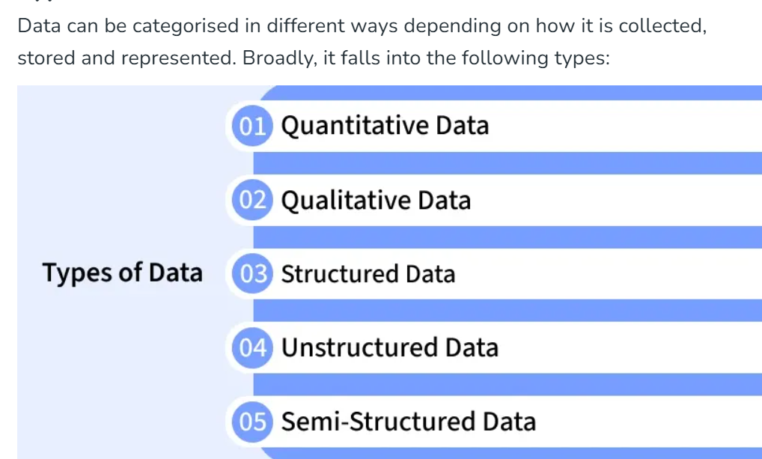
Types of Data

Slide 43
Types of Data
1. Quantitative Data
Quantitative data is information that can be measured, counted and expressed in numerical form. It provides objective values that can be analyzed statistically to identify patterns, trends and relationships.
Represents numbers and measurable values.
Can be divided into: Discrete data (Whole numbers) and Continuous data (Values on a scale).
Widely used in research, finance, engineering and business analytics.
Example: Age of people, number of customers visiting a store, temperature readings, sales revenue.

Slide 44
Types of Data
2. Qualitative Data
Qualitative data is descriptive, non-numeric information that explains qualities, characteristics or categories rather than quantities.
It helps understand opinions, experiences and meanings behind behaviours.
Focuses on qualities, attributes and categories rather than numbers.
Often collected through surveys, interviews or observations.
Useful for understanding opinions, motivations and behaviors.
Example: Customer feedback (“satisfied”, “unsatisfied”), product colors, interview transcripts, social media comments.

Slide 45
Types of Data
3. Structured Data
Structured data is information organized into a predefined format (rows and columns) that makes it easily searchable and manageable by traditional databases.
Stored in relational databases or spreadsheets.
Easy to process with SQL and other tools.
Best suited for tasks requiring accuracy and consistency.
Example: Bank transactions, employee records, product inventories.

Slide 46
Types of Data
4. Unstructured Data
Unstructured data is raw information that does not follow a predefined structure or format making it harder to organize and analyze with conventional tools.
Accounts for over 80% of data generated globally.
Requires advanced tools (AI, NLP, computer vision) to extract insights.
Common in social media, multimedia and IoT applications.
Example: Emails, images, videos, voice recordings, PDF documents.

Slide 47
Types of Data
5. Semi-Structured Data
Semi-structured data combines aspects of structured and unstructured data. It does not reside in traditional tables but still contains tags or markers that provide a loose structure.
Provides a balance between flexibility and structure.
Easier to analyze than unstructured data, but less rigid than structured data.
Often used in web applications, IoT devices and log systems.
Example: JSON files, XML documents, NoSQL databases, sensor logs.

Slide 48
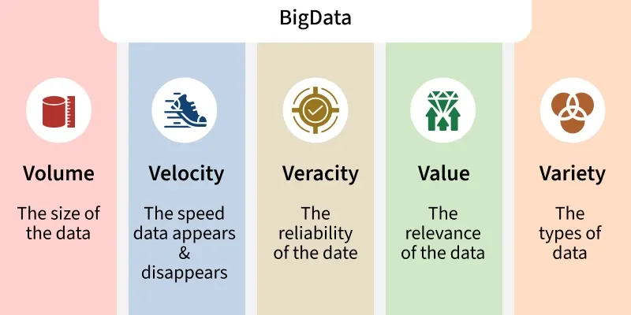
Types of Data
Big Data
When datasets grow in size, complexity and speed, traditional methods don’t suffice.
Big Data refers to datasets that are too large, too varied or too fast to be handled by traditional data processing tools.

Slide 49
Types of Data
The defining characteristics often called the Vs of Big Data are:
Volume: Massive amounts of data.
Velocity: Speed of generation and processing.
Variety: Different formats: structured, unstructured, semi-structured.
Veracity: Accuracy, trustworthiness of data to deal with noise and errors.
Value: The usefulness of data i.e. having data is not enough, we must extract value from data.

Slide 50
Role of Data in AI
Data is fundamental to Artificial Intelligence (AI) and Machine Learning (ML). AI models are trained on data and their performance, fairness, and reliability depends heavily on the quality, relevance and appropriateness of that data.
AI models depend on accurate, clean and relevant data.
Poor or biased data can make AI give wrong or unfair results.
Properly managed data improves AI accuracy and usefulness.
Examples
Netflix uses viewing history to suggest shows.
Self-driving cars use sensor data to navigate safely.

Slide 51
Applications
Business and Decision-Making: Organizations analyze data to identify trends, optimize operations and make informed decisions.
Healthcare: Patient records and medical data help in accurate diagnoses, personalized treatments and predicting disease outbreaks.
Finance: Banks and financial institutions rely on data for fraud detection, credit scoring and market analysis.
Technology and AI: Data fuels artificial intelligence and is used in applications like natural language processing, image recognition and predictive models.
Marketing and Customer Experience: Customer data enables targeted advertising, personalized offers and better engagement.

Slide 52
Challenges
Quality and Accuracy: If data is wrong or incomplete, the insights we get will also be wrong.
Volume and Complexity: There is a huge amount of data in many formats, which can be hard to handle with normal tools.
Privacy and Ethics: Personal data must be protected to avoid misuse and to follow laws like GDPR or CCPA.
Bias and Fairness: If data reflects existing biases, AI or machine learning can make unfair decisions.
Management Effort: Storing, processing and maintaining data can be costly and time-consuming.

Slide 53
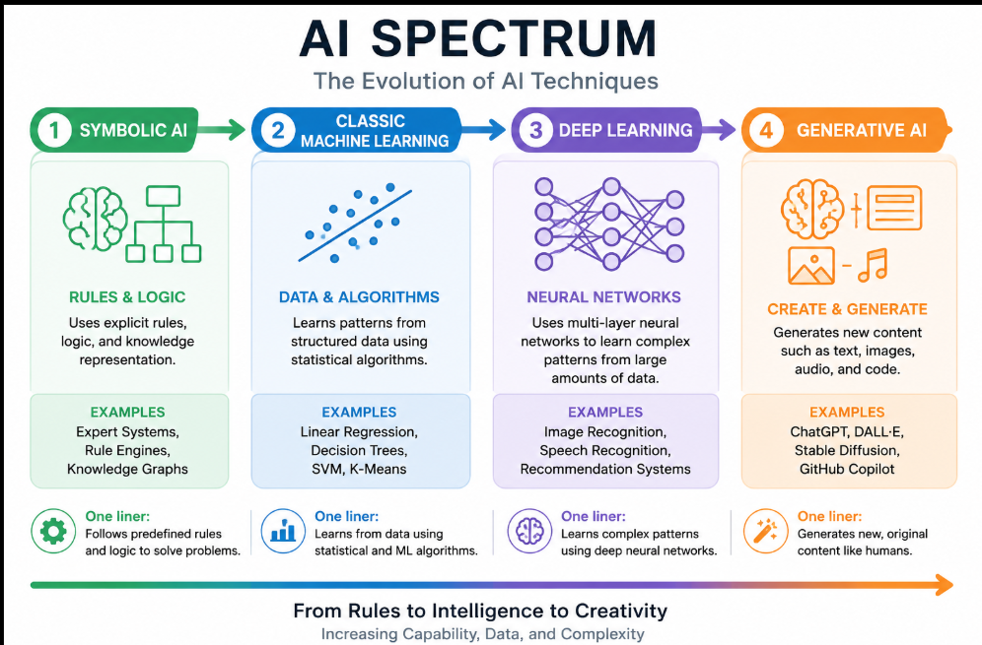
AI Spectrum

Slide 54
AI Spectrum - Symbolic AI
Symbolic AI uses a rule-based system to mimic human decision-making. Essentially, symbolic AI represents knowledge using symbols and logical rules.
Symbolic AI is one of the earliest approaches to artificial intelligence where knowledge is represented using symbols, rules, and logic created by humans.
In symbolic AI, computers solve problems using:
Rules
Logic and relationships
Knowledge representations
Reasoning systems
Simple definition:
Symbolic AI = AI that works using human-defined rules and logical reasoning.
Example rule:
IF temperature > 38°C THEN patient_has_fever = TRUE
The system evaluates rules like this to make decisions.

Slide 55
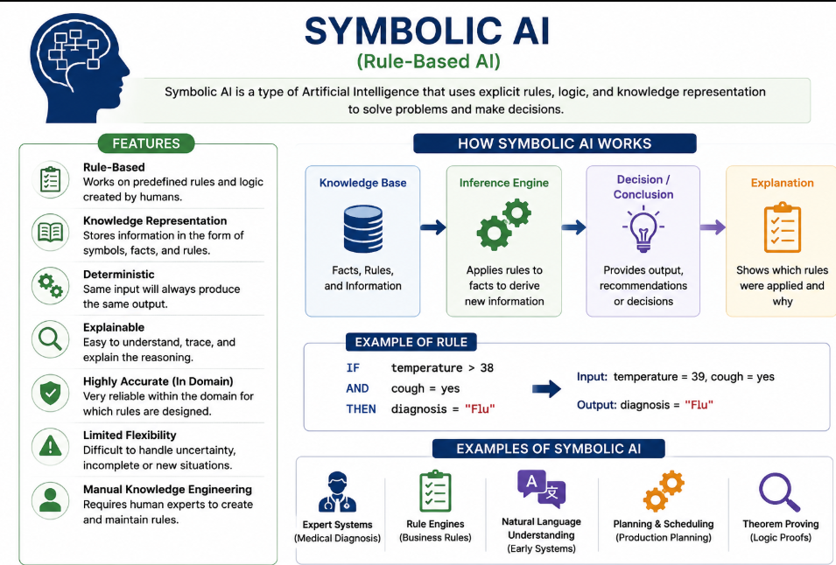
AI Spectrum - Symbolic AI

Slide 56
AI Spectrum - Symbolic AI
Why it is called “Symbolic” AI
It is called symbolic because knowledge is represented using symbols that represent real-world objects or concepts.
Symbol Meaning
Fever Patient temperature above threshold
Rain Weather condition
Wet_ground Result of rain
Example relationship:
Rain → Wet_ground
The AI uses these symbols and relationships to perform reasoning.

Slide 57
AI Spectrum - Symbolic AI
Example of Symbolic AI System
Expert systems are the most famous symbolic AI systems.
They mimic human expert decision-making.
Example: Medical diagnosis system.
Rules:
IF fever AND cough THEN possible disease = flu
Input:
fever = TRUE cough = TRUE
Output:
Diagnosis = Flu

Slide 58
AI Spectrum - Symbolic AI
Types of Symbolic AI
Rule-Based
Systems Based Systems
Logic-Based AI
Search-Based AI
Knowledge Representation Systems
Planning Systems
Search Based AI

Slide 59
AI Spectrum - Symbolic AI
Types of Symbolic AI
1. Rule-Based Systems (Expert Systems)
Rule-based systems use IF–THEN rules to make decisions.
A knowledge base stores rules, and an inference engine applies those rules to solve problems.
Example:
IF patient has fever AND cough THEN possible disease = flu
Applications
Medical diagnosis - MYCIN (1970s) – One of the earliest expert systems developed at Stanford University to diagnose bacterial infections and recommend antibiotics.
Financial decision systems – Loan Approval, Credit Card eligibility, Fraud Detection
Customer support systems - Banking chatbots, Telecom IVR systems E-commerce customer support
Limitations of Symbolic AI
Cannot learn from data
All knowledge must be manually programmed.

Slide 60
AI Spectrum - Symbolic AI
2.Logic-Based AI
Logic-based AI uses mathematical logic to represent knowledge and perform reasoning.
It often uses predicate logic or first-order logic.
Example:
All humans are mortal Socrates is a human Therefore, Socrates is mortal
The AI uses logical rules to infer new information.
A programming language commonly used for logic-based AI is Prolog.
Applications
Automated theorem proving -Lean Theorem Prover, Prover9
Knowledge reasoning systems -Medical diagnosis, Legal reasoning, Decision support systems
Natural language understanding (early systems) -Voice assistants, Command interpreters
Famous Early Systems
ELIZA (1966) – Simulated a psychotherapist using pattern matching.
SHRDLU (1970) – Understood commands in a simple blocks world using logical reasoning.

Slide 61
AI Spectrum - Symbolic AI
3.Knowledge Representation Systems
These systems store knowledge in structured formats so computers can understand relationships between concepts.
Common representations include:
Semantic Networks
Information is represented as nodes and relationships.
Example:
Dog → is a → Animal Dog → has → Tail
Frames
Frames store knowledge in structured objects with attributes.
Example:
Frame: Car Attributes: Wheels = 4 Engine = Yes Fuel = Petrol/Diesel
Applications
Knowledge graphs
Intelligent databases
Semantic web systems

Slide 62
AI Spectrum - Symbolic AI
4. Planning Systems
Planning systems help AI plan sequences of actions to achieve goals.
Example:
Goal: Make tea
Steps:
Boil water
Add tea leaves
Pour into cup
The AI decides the best sequence of actions to reach a goal.
Applications
Robotics
Logistics planning
Automated decision systems

Slide 63
AI Spectrum - Symbolic AI
5.Search-Based AI
Search-based AI finds solutions by exploring possible states and paths.
Example problems:
Maze solving
Chess playing
Pathfinding
Algorithms used include:
Breadth-First Search (BFS)
Depth-First Search (DFS)
A* Search
A famous symbolic AI example is Deep Blue, which defeated world champion Garry Kasparov in 1997.

Slide 64
Advantages of Symbolic AI
Provides clear and explainable decision-making.
Easy to understand and interpret by humans.
Strong in logical reasoning and rule-based problem solving.
Requires very little data to operate.
Produces consistent and predictable results.
Easy to modify by updating rules.

Slide 65
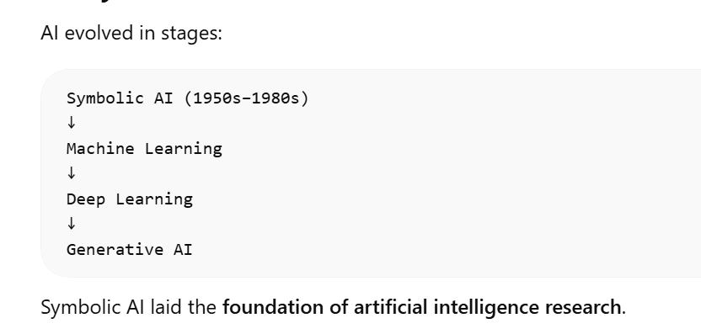
Limitations of Symbolic AI
Cannot learn from data
All knowledge must be manually programmed.
It struggles with vague or incomplete data.
Writing rules manually for complex systems becomes difficult.

Slide 66
AI Spectrum - Classical Machine Learning
Classical machine learning is a data-driven approach that requires data preparation, feature selection and model training, and can be used for tasks such as defect categorization and predicting software problems.
Classical Machine Learning (ML) is a type of artificial intelligence where computers learn patterns from data instead of being explicitly programmed with rules.
In Symbolic AI, humans write rules. In Machine Learning, the system learns the rules automatically from data.
Simple definition:
Classical Machine Learning = Algorithms that learn patterns from data to make predictions or decisions.
Example: Predict whether an email is spam or not spam based on previous email data.

Slide 67
AI Spectrum- Classical Machine Learning
Data
Algorithm
Model
Prediction
Historical examples used for training
Mathematical method used to learn patterns.
The trained system that makes predictions.
Output generated by the model

Slide 68
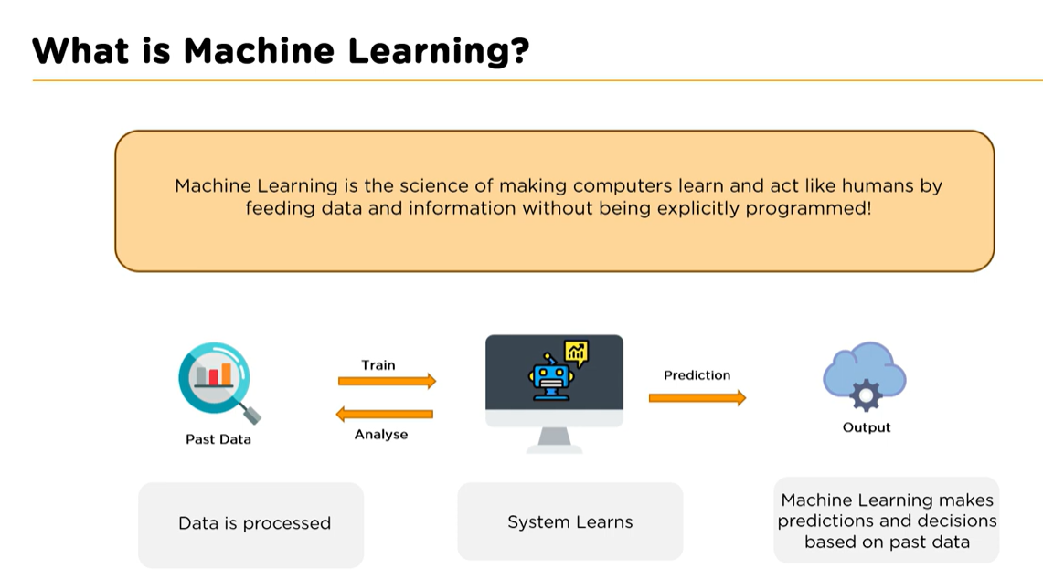
AI Spectrum- Classical Machine Learning

Slide 69
AI Spectrum- Classical Machine Learning
Example:
Training Data: house size, location, price ↓ Model learns relationship ↓ Predict price of new house

Slide 70
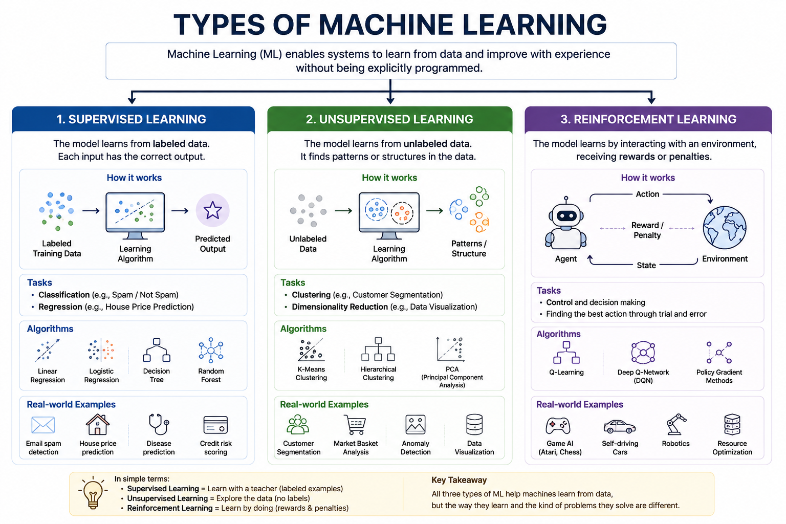
AI Spectrum- Types of Machine Learning

Slide 71
AI Spectrum- Classical Machine Learning
1. Supervised Learning
In supervised learning, the model learns using labeled data.
Labeled data means input + correct output.
Example dataset:
House Size Price
1000 sq ft 50,000
Common Algorithms
Linear Regression
Logistic Regression
Decision Trees
Support Vector M
Example Applications
Spam detection
Credit risk prediction
Medical diagnosis
Fraud detection
Example:
Input: Email text Output: Spam or Not Spam

Slide 72
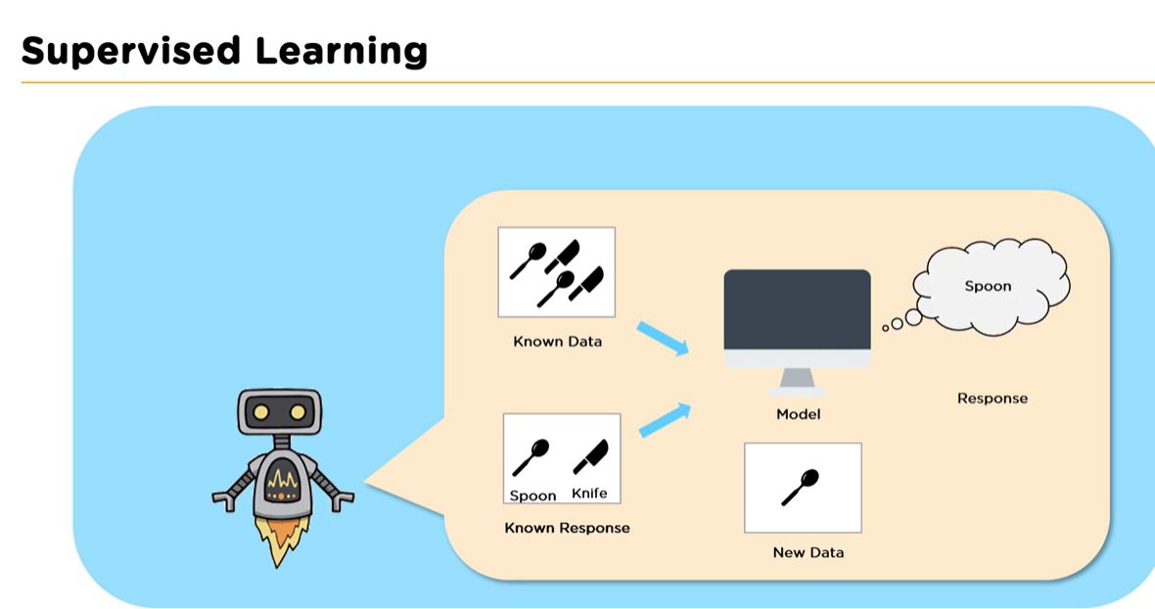
AI Spectrum- Classical Machine Learning

Slide 73
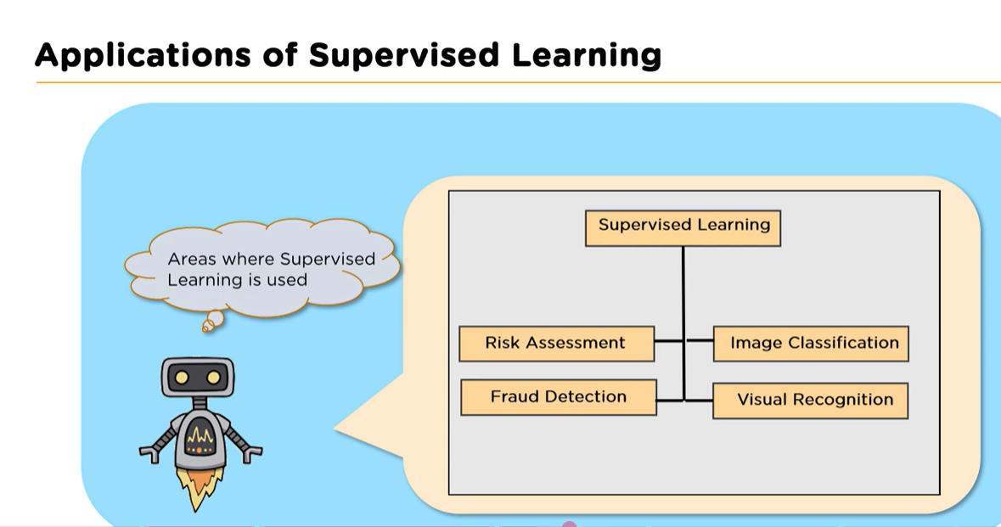
AI Spectrum- Classical Machine Learning

Slide 74
AI Spectrum- Classical Machine Learning
2. Unsupervised Learning
In unsupervised learning, the data does not contain labels.
The algorithm tries to discover patterns or structures in the data.
Example dataset:
Customer ID Age Purchase Amount
1 22 500
2 45 2000
3 21 450
The model groups customers with similar behavior.
Common Algorithms
K-Means Clustering
Hierarchical Clustering
DBSCAN
Principal Component Analysis (PCA)
Example Applications
Customer segmentation
Market analysis
Pattern discovery
Example result:
Group 1: Young customers Group 2: High spending customers

Slide 75
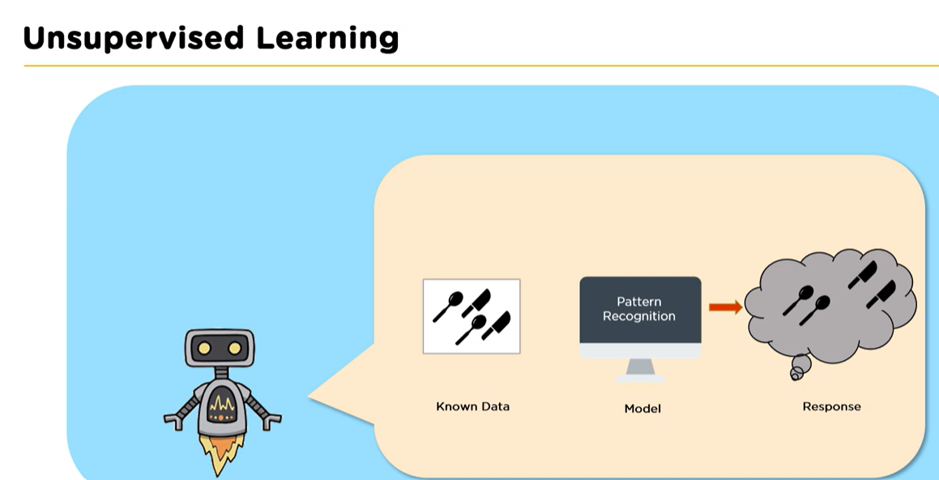
AI Spectrum- Classical Machine Learning

Slide 76
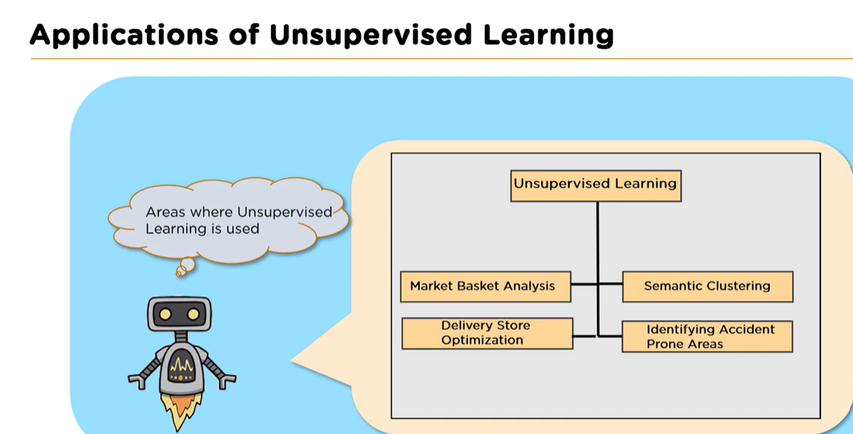
AI Spectrum- Classical Machine Learning

Slide 77
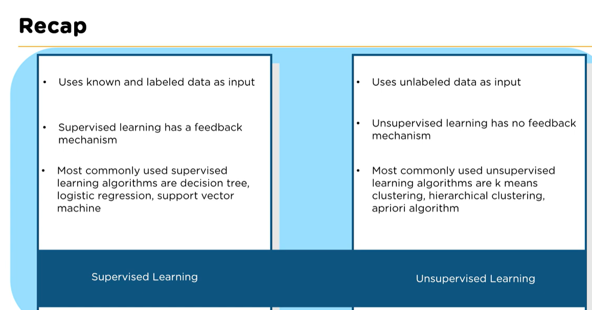
AI Spectrum- Classical Machine Learning

Slide 78
AI Spectrum- Classical Machine Learning
3. Reinforcement Learning
In reinforcement learning, the model learns by interacting with an environment and receiving rewards or penalties.
Example:
Action → Reward or Penalty
The goal is to maximize rewards over time.
Example applications:
Self-driving cars
Game-playing AI (Chess, Go)
Robotics
Example:
Move in game → reward Bad move → penalty
The AI gradually learns the best strategy.

Slide 79
Advantages of Classical Machine Learning
Learns from data
The system improves as more data becomes available.
Handles complex relationships
ML can detect patterns humans may miss.
Useful for predictive tasks
Examples:
Sales forecasting
Risk prediction
Recommendation systems

Slide 80
Limitations of Classical Machine Learning
Requires feature engineering
Humans must manually select useful features.
Limited performance on unstructured data
Classical ML struggles with:
Images
Speech
Natural language
These tasks are better handled by deep learning.
Requires good quality data
Poor data leads to poor models.

Slide 81
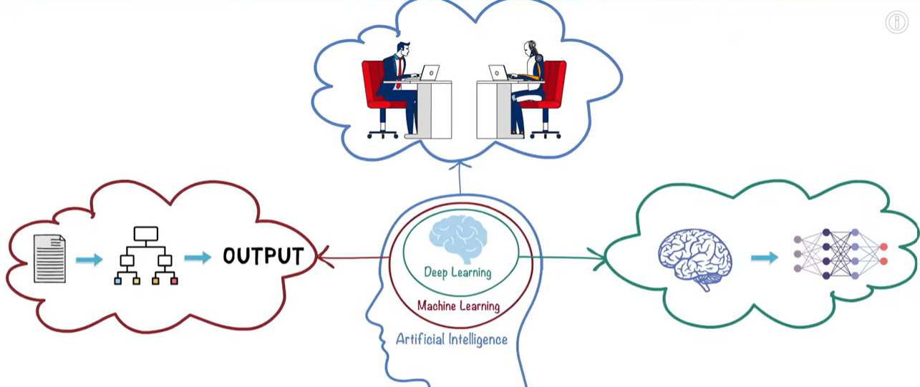
AI Spectrum- Deep Learning
Deep learning uses machine learning structures called neural networks to automatically learn features from data.
Deep learning models can find patterns in very large and complex datasets, such as images, video, audio, or text, without the need for users to manually define features, though in practice, it may still require human involvement in tasks such as data annotation, model tuning, or result validation.

Slide 82
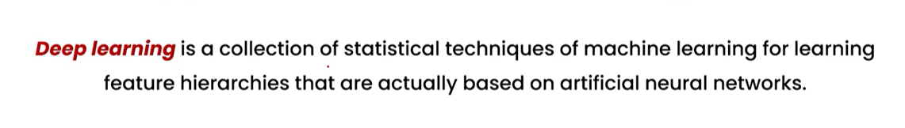
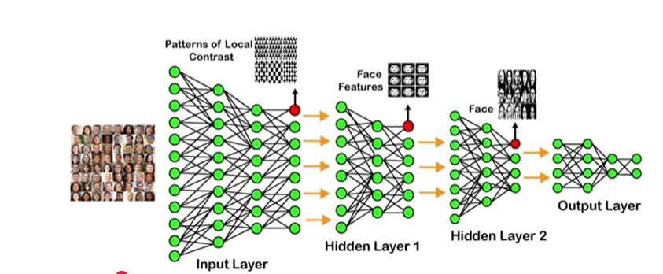
AI Spectrum- Deep Learning

Slide 83
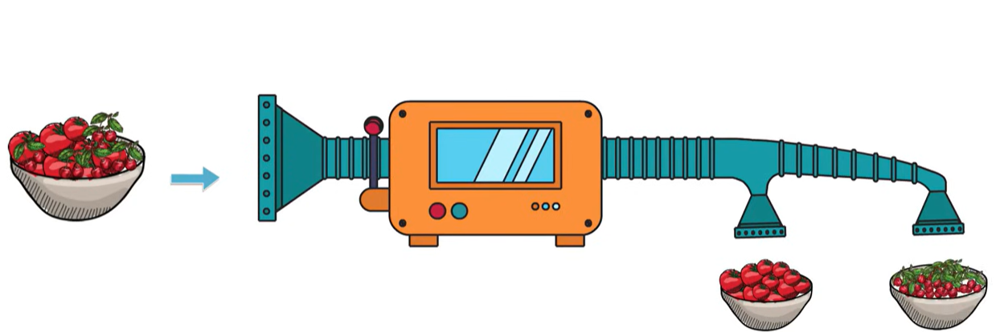
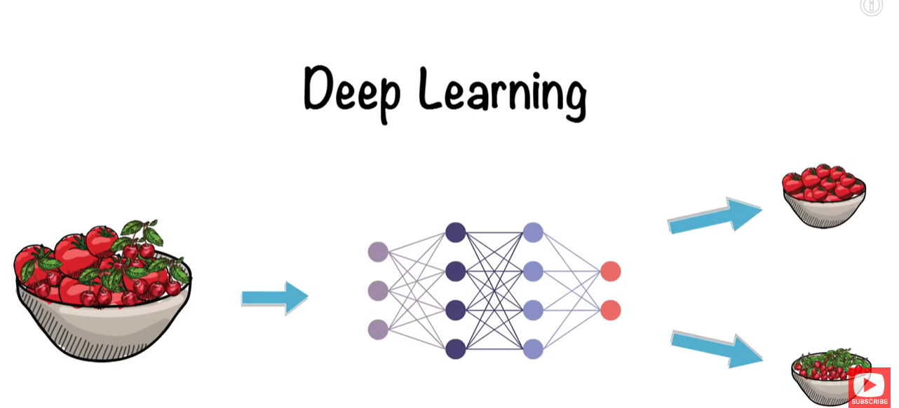
AI Spectrum- Deep Learning

Slide 84
AI Spectrum- Deep Learning
What are Neural Networks?
Deep learning uses Artificial Neural Networks (ANNs).
They are inspired by neurons in the human brain.
Each neuron:
Receives input
Processes the input
Sends output to the next neuron
Simple representation:
Input → Neuron → Neuron → Output
Thousands or millions of neurons work together in a deep learning model.

Slide 85
AI Spectrum- Deep Learning
Understanding with a Simple Example
Imagine teaching a computer to recognize a cat in an image.
A deep learning model learns step-by-step:
Layer 1: Detects simple features
edges
lines
Layer 2: Detects shapes
ears
eyes
Layer 3: Detects objects
face
body
Final Layer: Recognizes
This is a CAT
So deep learning builds understanding layer by layer.

Slide 86
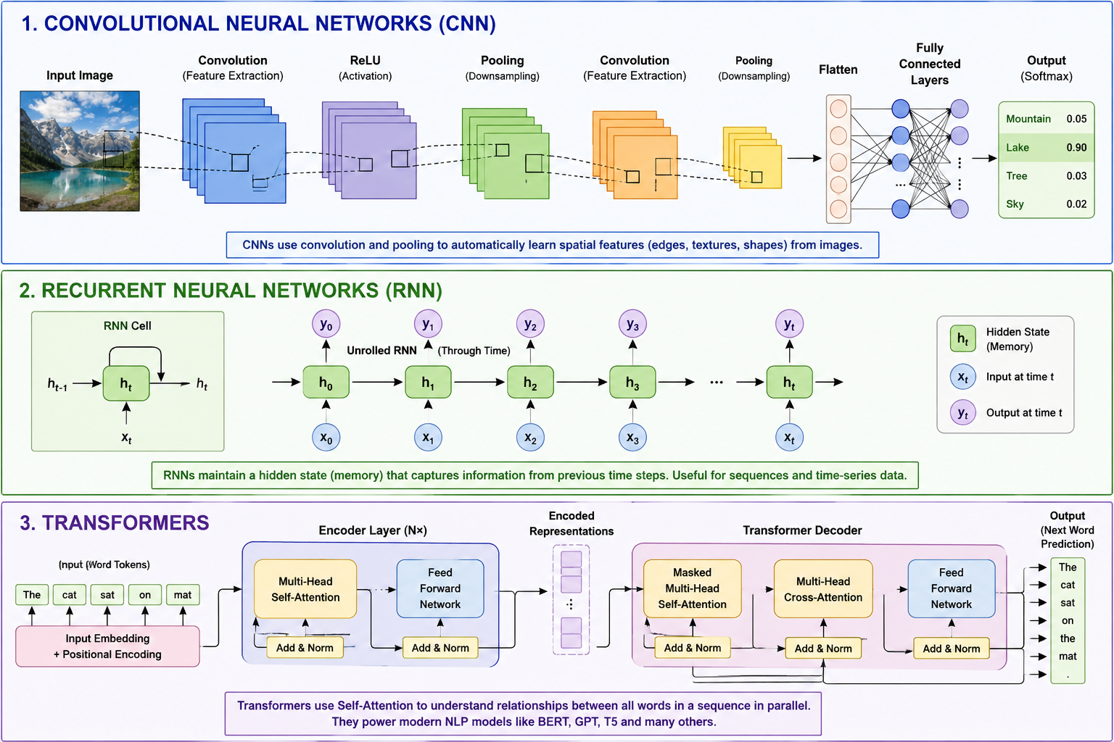
AI Spectrum- Types of Deep Learning
.

Slide 87
AI Spectrum- Deep Learning
1. Convolutional Neural Networks (CNN)
Used for image processing.
Applications:
Face recognition
Medical imaging
Self-driving cars
2. Recurrent Neural Networks (RNN)
Used for sequence data like text or speech.
Applications:
Language translation
Speech recognition
3. Transformers
Used in modern AI systems and Large Language Models.
They power tools like:
ChatGPT
Gemini
Transformers are very powerful for text understanding and generation.

Slide 88
AI Spectrum- Deep Learning
Advantages of Deep Learning
Learns Automatically
Does not require manually written rules.
High Accuracy
Performs very well with large datasets.
Handles Complex Problems
Good for images, speech, and language.

Slide 89
AI Spectrum- Deep Learning
Limitations of Deep Learning
Needs Large Data
Deep learning models require huge datasets.
Requires High Computing Power
Training often needs GPUs or specialized hardware.

Slide 90
Basic terminology (model, training, inference, features, labels)
What is Training in AI
Training is the process of teaching an AI model to learn patterns from data so that it can make predictions, classifications, or generate new content when it receives new input.
A simple way to think about it:
Training = showing examples to the model + measuring its mistakes + adjusting the model + repeating the process until it learns useful patterns.
Common types of training
Pre-training: A model learns broad patterns and language understanding from massive, general-purpose datasets before being adapted to specific tasks.
Fine-tuning: The pre-trained model is further trained on a smaller, domain-specific dataset to improve performance for targeted use cases.
Supervised learning: The model learns from labelled examples where the correct output is provided for each input.
Unsupervised learning: The model discovers hidden patterns or groupings in unlabeled data without being given explicit answers.

Slide 91
AI Spectrum- Training
Training outputs
The result of the training process is a static model file containing:
Weights: The learned parameters that determine how input data is transformed.
Embeddings: Vector representations of data that capture semantic meaning.
Learned representations: The model’s internal map of how different features relate to one another.

Slide 92
AI Spectrum- Inference
What is Inference in AI?
Inference is the process of using a trained AI/ML model to make a prediction, classification, decision, or generate new content from new input data.
In simple words:
Training = AI learns 🧠 Inference = AI uses what it learned 🎯

Slide 93
AI Spectrum- Inference
Simple Example
Suppose we train an AI model to recognize cats and dogs.
During Training
We give the model thousands of images:
Cat Image → Cat
Dog Image → Dog
Cat Image → Cat
Dog Image → Dog ↓
TRAINING
Trained Model
The model learns patterns such as:
Shapes
Ears
Eyes
Fur
Face structure
Body characteristics
During Inference
We give it a new image it has never seen before.
New Image
↓
Trained Model
↓
Prediction
↓
Cat = 95%
Dog = 5%
The model is performing inference.

Slide 94
AI Spectrum - Training vs Inference
Training | Inference
Model learns | Model applies what it learned
Uses training data | Uses new input
Parameters are updated | Parameters normally stay fixed
Calculates loss | Produces output
Uses backpropagation | Usually only forward computation
Computationally expensive | Usually faster
Happens during model development | Happens when users use the model

Slide 95
AI Spectrum - Training vs Inference
What Happens During Inference?
The basic inference process is:
New Input
↓
Preprocessing
↓
Trained Model
↓
Forward Pass
↓
Prediction / Generation
↓
Output

Slide 96
AI Spectrum - Training vs Inference
Example: Image Recognition
Suppose a CNN was trained to identify animals.
Training
Millions of Images
↓
CNN
↓
Learn Features
↓
Update Weights
↓
Trained CNN
Inference
New Image
↓
CNN
↓
Prediction
↓
"Dog – 98%“
The CNN is now inferring what the image contains.

Slide 97
AI Spectrum - Training vs Inference
How Text Generation Works During Inference
Consider:
"The capital of India is"
The model calculates probabilities for possible next tokens.
For example:
Delhi → 95%
Mumbai → 1%
Bangalore → 0.5%
Chennai → 0.2%
Others → ...
The model selects a token based on its decoding strategy.
Then it predicts the next token again.
"The capital of India is"
↓
"New token"
↓
"The capital of India is Delhi"
↓
Predict next token
↓
Continue...
This continues until the model reaches an appropriate stopping point.

Slide 98
AI Spectrum- Models
An AI model is a computer program trained on a large dataset to recognize patterns, make decisions, or generate new content without human help. It uses math and algorithms to turn new inputs into accurate outputs.
Simple definition:
AI Model = A trained mathematical/computational system that takes input and produces an output.
How AI Models Work
Data Input: You feed the system a large amount of information, like text, photos, or numbers.
Pattern Learning: The program studies the data to find hidden rules and connections.
Parameters: It adjusts tiny internal settings (called weights) to make its guesses more precise.
Prediction: When given fresh, unseen data, it applies what it learned to give an answer.

Slide 99
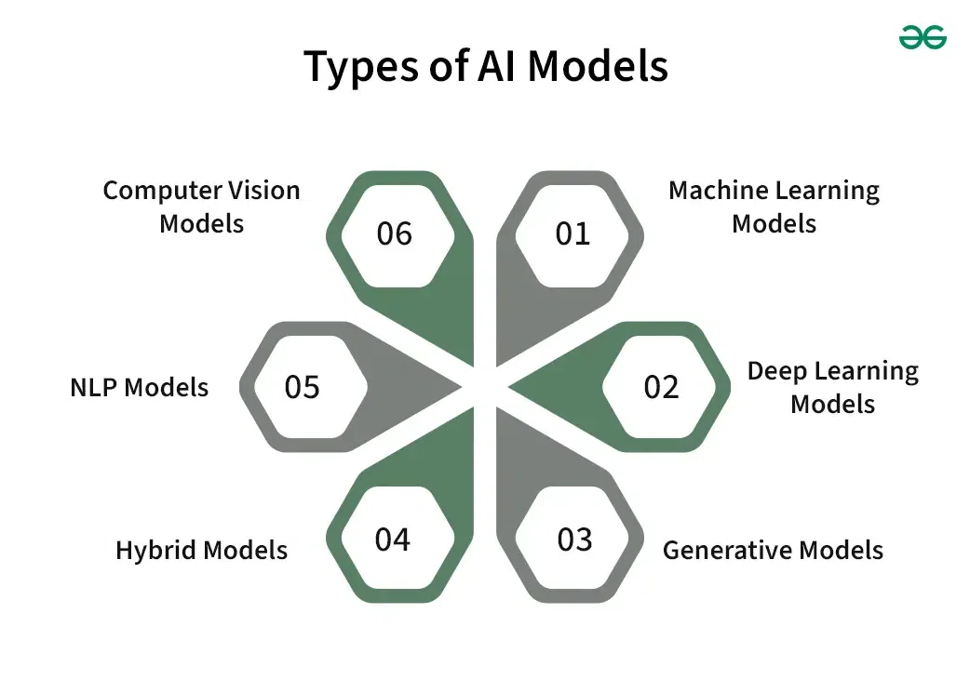
AI Spectrum- Models

Slide 100
AI Spectrum- Models - Machine Learning Models
Machine Learning (ML) models learn patterns from existing data and use those patterns to make predictions or decisions.
Basic flow:
Training Data → ML Model → Prediction
Examples
Predict house prices
Detect spam emails
Predict customer churn
Identify fraudulent transactions
Recommend products
Common ML models
Linear Regression
Logistic Regression
Decision Trees
Random Forest
Support Vector Machines (SVM)
K-Nearest Neighbors (KNN)
Naive Bayes
Example:
Customer data → ML model → Customer will churn / will not churn

Slide 101
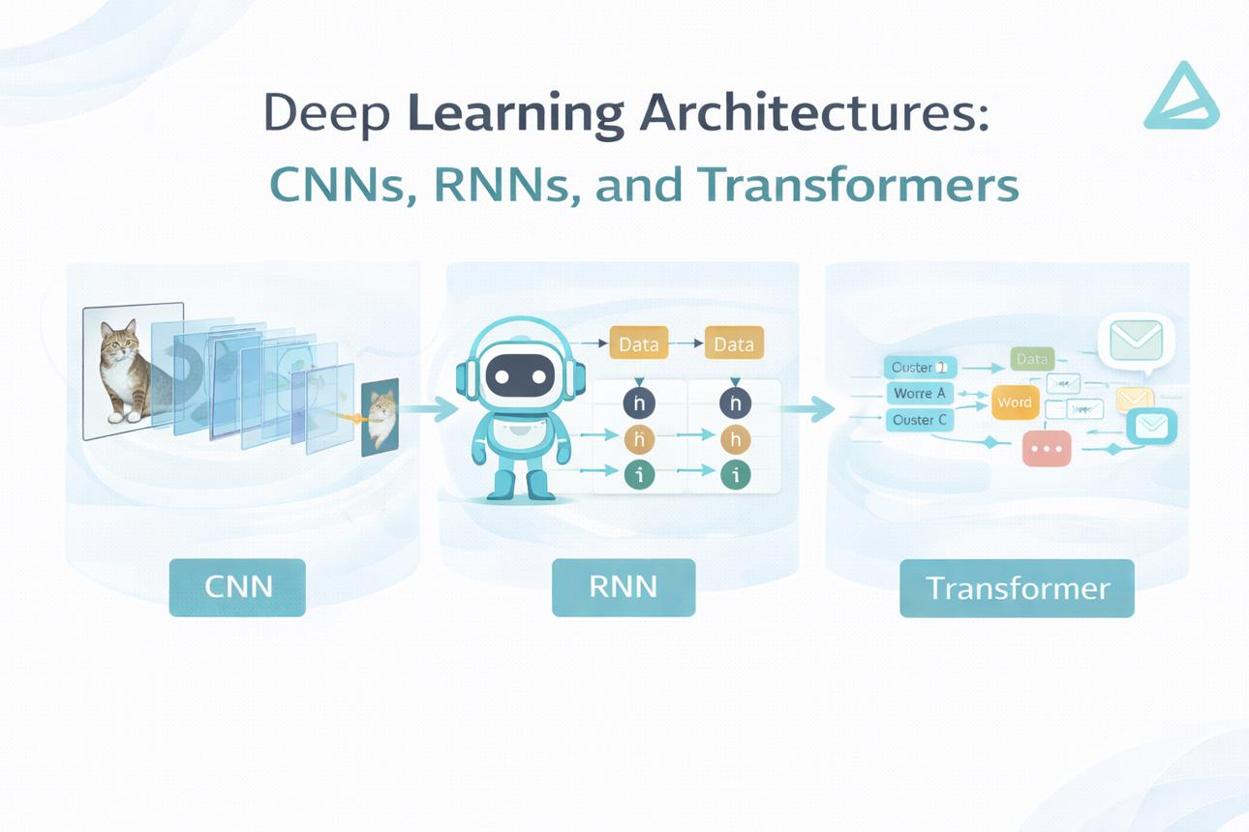
AI Spectrum- Models Deep Learning Models
Deep Learning (DL) models are a type of machine-learning model based mainly on artificial neural networks with multiple layers.
They are particularly useful when dealing with large and complex datasets such as images, speech, video, and text.

Slide 102
AI Spectrum- Models Deep Learning Models
Common deep-learning architectures
ANN – Artificial Neural Network
CNN – Convolutional Neural Network
RNN – Recurrent Neural Network
LSTM – Long Short-Term Memory
Transformer
Examples
Face recognition
Speech recognition
Image classification
Language understanding
Autonomous driving

Slide 103
AI Spectrum-Models - Generative Models
Generative models are AI models that learn patterns from existing data and can generate new content.
Instead of simply answering:
"What category does this belong to?"
they can answer:
"Can I create something new based on what I learned?"
Examples of technologies
Large Language Models (LLMs)
Diffusion models
GANs
Multimodal generative models
Example:
Prompt: "A robot teaching students" → Generative AI → New image
Another example:
Prompt → LLM → Java Selenium test script
Traditional vs Generative AI
Traditional AI:
Image → Model → Cat
Generative AI:
Text prompt → Model → New image of a cat

Slide 104
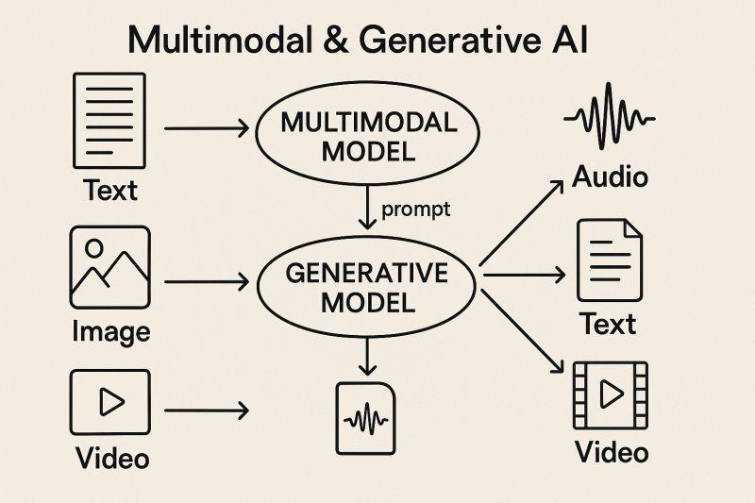
AI Spectrum-Models - Generative Models

Slide 105
AI Spectrum-Models - Hybrid models
Hybrid models combine two or more AI techniques or models to solve a problem more effectively.
For example, a system might combine:
Machine Learning + Deep Learning
Rule-based systems + Machine Learning
Computer Vision + NLP
ML + Generative AI

Slide 106
AI Spectrum-Models - Hybrid models
Example: Smart customer-support system
A customer sends a message.
NLP model ↓ Understands the customer's question
ML model ↓ Classifies the issue
Generative AI model ↓ Generates a response
Human/Business rules ↓ Approves or controls the response
Why use hybrid models?
Because one model may not be good at everything.
Hybrid approach = combine the strengths of multiple approaches.

Slide 107
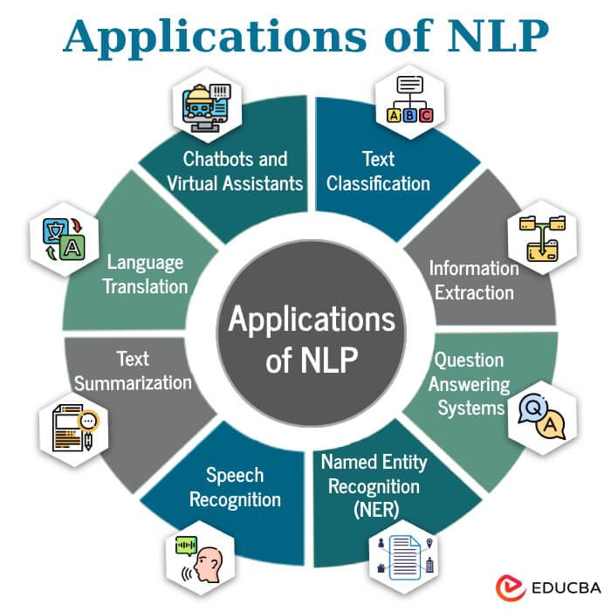
AI Spectrum-Models - NLP Models
NLP = Natural Language Processing
NLP models are designed to work with human language
They process:
Text
Speech
Documents
Conversations

Slide 108
AI Spectrum-Models - NLP Models
Applications
Sentiment Analysis
"This product is excellent!" → Positive
Translation
English → Hindi
Text Summarization
Long document → Short summary
Question Answering
Question → Answer
Chatbots
User → NLP model → Response
Modern NLP
Modern NLP is heavily based on Transformer architectures.
Large Language Models are an important modern category of NLP models.

Slide 109
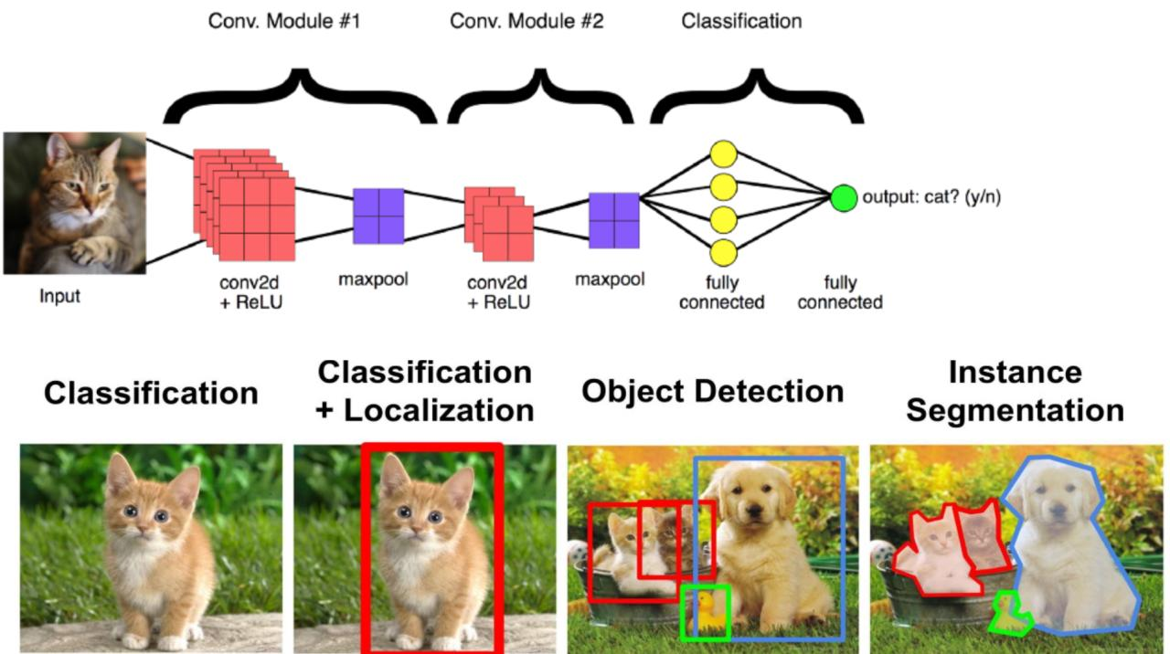
AI Spectrum-Models - Computer Vision Models —
Computer Vision models enable computers to understand and analyse images and videos.
Medical Imaging
AI can analyze X-rays, CT scans, MRI images, etc.

Slide 110
AI Spectrum-Models
AI MODELS
│
┌───────────────┼────────────────┐
│ │ │
ML Models Deep Learning Generative Models
│ │ │
│ ┌──────┼──────┐ │
│ │ │ │ │
│ CNN RNN Transformer │
│ │ │ │ │
│ └──────┼──────┘ │
│ │ │
│ ┌───────┴───────┐ │
│ │ │ │
NLP Models Computer Vision
│ │
└──────── Hybrid Models ──┘

Slide 111
AI Spectrum-Models
Quick Comparison
Model Type | Main Purpose | Example
Machine Learning | Predict/classify | Fraud detection
Deep Learning | Learn complex patterns | Face recognition
Generative Models | Create new content | Generate text/image
Hybrid Models | Combine techniques | AI customer-support system
NLP Models | Understand language | Chatbot
Computer Vision | Understand images/video | Object detection

Slide 112
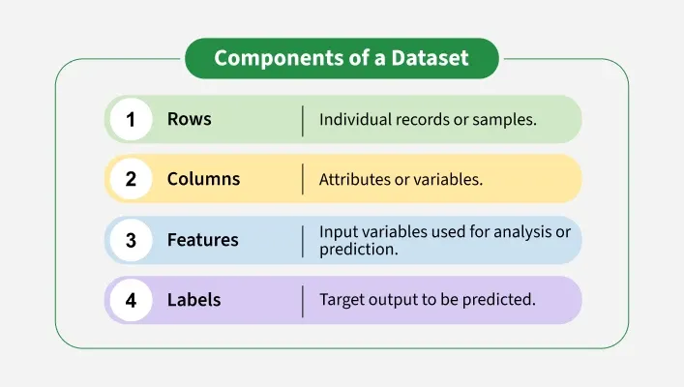
AI Spectrum- Datasets
A dataset is a structured collection of related data, usually organized in rows and columns that represents information about a specific category or domain.
It forms the foundation for many operations, techniques and models used across industries.

Slide 113
AI Spectrum- Datasets
For example, A student dataset may include rows for each student and columns for attributes like name, age, grade and marks.
Importance of Dataset
Some reasons why datasets are important in analysis and machine learning are:
Analysis: Provide the raw material required for analysis and decision making.
Training Machine Learning Models: Enable the training and testing of machine learning and AI models.
Discover Patterns and Correlations: Help uncover patterns, correlations and insights across domains.
Innovation: Support research and development in industries like healthcare, finance and education.
Evaluation and Standards: Allow reproducibility and benchmarking in academic and professional projects.

Slide 114
AI Spectrum - Types of Dataset
There are various types of datasets available out there. Some of them are:
Numerical Dataset: Contains numeric data points that can be analyzed using mathematical or statistical methods. For example temperature dataset.
Categorical Dataset: Represents discrete categories or groups such as color, gender, occupation or sports.
Time Series Dataset: Records data over a period of time to track trends or changes. For example stock prices.
Ordered Dataset: Contains ranked or ordinal data where the order matters but not the exact difference between values. Example can be customer reviews, survey ratings or movie rankings.
Image Dataset: Consists of images used for classification, recognition or analysis tasks. For example medical imaging for disease detection.
Web Dataset: Collected from APIs or web sources, usually stored in structured formats like JSON for further analysis.
File based Dataset: Stored in files such as CSV, Excel (.xlsx) or text files for easy access and manipulation.

Slide 115
AI Spectrum - Features of a Dataset
Some possible features of a dataset are:
Numerical Features: These may include numerical values such as height, weight and so on. These may be continuous over an interval or discrete variables.
Categorical Features: These include multiple classes or categories such as gender, colour and so on.
Size of the Data: It refers to the number of entries and features it contains in the file containing the Dataset.
Data Entries: These refer to the individual values of data present in the Dataset.
Target Variable: This is the main feature in a dataset that we want to predict or explain using the other features.

Slide 116
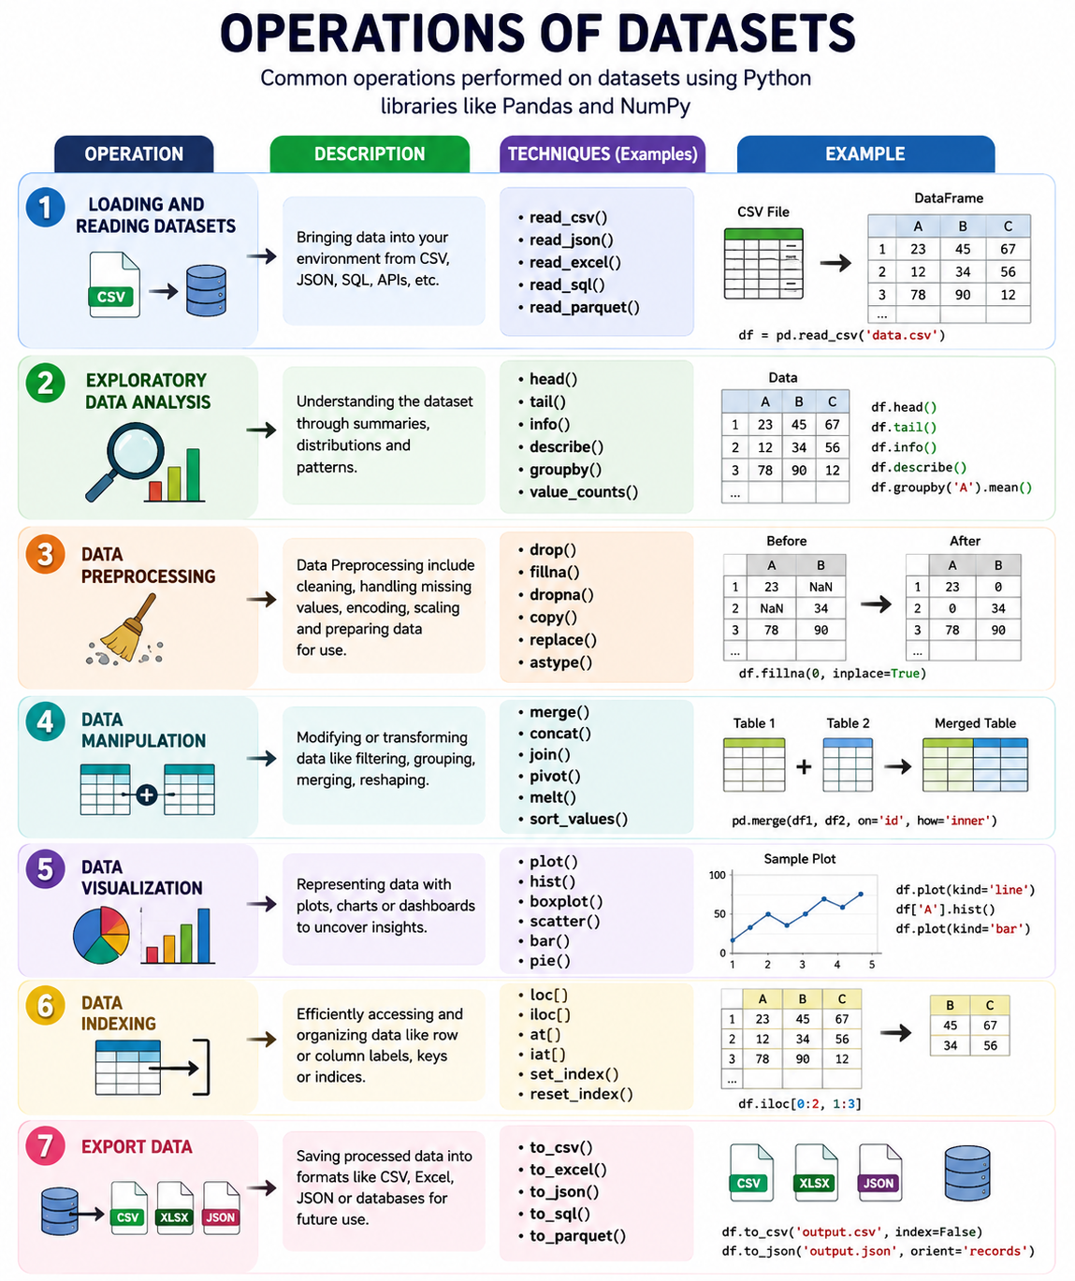
AI Spectrum – Operations of Dataset

Slide 117
AI Spectrum - Challenges in Working with Dataset
Common challenges faced when working with datasets are:
Quality Issues: Poorly collected or inconsistent data can mislead analysis and reduce the accuracy of models.
Missing Data: Incomplete records create gaps that make it harder to draw reliable conclusions or train models effectively.
Bias: When datasets are unbalanced or unrepresentative, the resulting models may produce unfair or skewed outcomes.
Scalability: Very large datasets can be challenging to clean, store and process efficiently with limited resources.
Privacy Concerns: Sensitive or personal data requires strict handling to ensure compliance with privacy and security standards.

Slide 118
AI Spectrum - Applications of Dataset
Here are some of the applications of dataset:
Machine Learning Training: Datasets are used to train models for tasks like image recognition, natural language processing or fraud detection.
Business Analytics: Companies analyze sales, customer and financial datasets to make informed decisions.
Healthcare: Patient records, medical images and genomic datasets support disease diagnosis and treatment planning.
Education and Research: Public datasets help students and researchers experiment validate hypotheses and build new solutions.
Recommendation Systems: Datasets of user behavior like purchases, clicks, ratings are used to suggest products, movies or music.

Slide 119
AI Spectrum – Features and labels
Features and Labels in AI / Machine Learning
When we train a machine learning model, we usually provide it with data containing:
Features → the information used to make a prediction
Labels → the correct answer or outcome the model should learn to predict
What is a Feature?
A feature is an input variable or characteristic that provides information to the AI/ML model.
Think of features as clues given to the model.
Example: Predicting house price
These characteristics are the features.
The model uses these features to predict the house price.

Slide 120
AI Spectrum – Features and labels
These characteristics are the features.
The model uses these features to predict the house price.
Feature | Example value
Area | 1500 sq. ft.
Number of bedrooms | 3
Number of bathrooms | 2
Location | Bangalore
Age of house | 5 years

Slide 121
AI Spectrum – Features and labels
2. What is a Label?
A label is the expected output or answer that the model is trying to learn.
For the house-price example:
Features:
Area = 1500 sq. ft.
Bedrooms = 3
Bathrooms = 2
Location = Bangalore
Age = 5 years
Label:
House Price = ₹80 lakh
So:
Features → Model → Label/Prediction

Slide 122
AI Spectrum – Features and labels
Simple Example: Spam Email Detection
Suppose we want AI to identify whether an email is spam.
Here, the features describe the email, while Spam is the label.
Another example:
The model learns patterns from these examples.
Email features | Label
Few links, known sender | Not Spam
"Win ₹10,000", unknown sender | Spam
Normal business communication | Not Spam
"You won a prize!" | Spam
Features | Label
Contains "Free"
Contains many links
Sender is unknown | Spam
Contains "Congratulations"
Contains "Win money"

Slide 123
AI Spectrum – Features and labels
Feature | Label
Input to the model | Output the model learns to predict
Describes the data | Represents the answer
Also called independent variable | Also called target/dependent variable
Example: Age, salary, location | Example: Loan approved
Available before prediction | Usually what we want to predict

Slide 124
AI Spectrum – Features and labels
Problem | Features | Label
House price prediction | Area, rooms, location, age | Price
Spam detection | Words, links, sender | Spam / Not Spam
Student result prediction | Attendance, assignments, previous marks | Pass / Fail
Customer churn | Usage, tenure, complaints, plan | Churn / No Churn
Disease prediction | Age, symptoms, test results | Disease / No Disease
Loan approval | Income, credit score, loan amount | Approved / Rejected

Slide 125
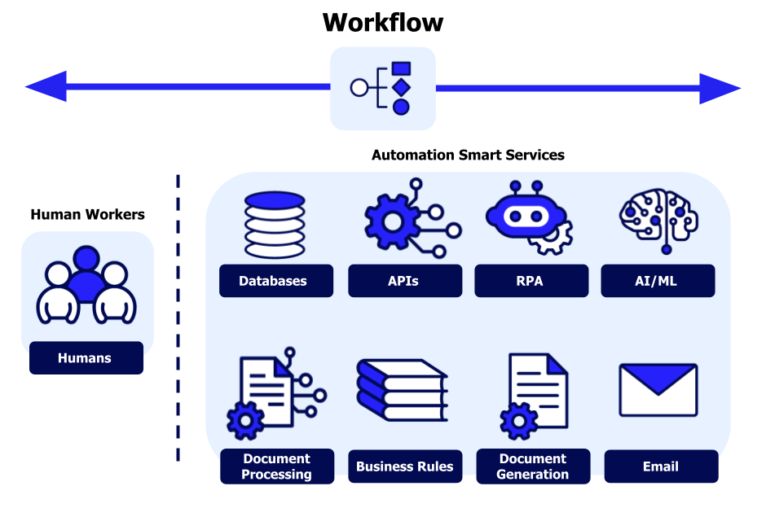
Overview of AI workflows

Slide 126
Overview of AI workflows
Artificial intelligence (AI) workflow is the process of using AI-powered technologies and products to automate tasks and streamline activities within an organization.
An AI workflow is a sequence of steps through which an AI system takes data or user input, processes it, applies an AI model, and produces an output, prediction, or action.
Basic AI Workflow
Problem Definition → Data → Preparation → Model → Training → Evaluation → Deployment → Inference → Monitoring

Slide 127
Overview of AI workflows
Key characteristics of AI workflows
What sets AI workflows apart from conventional automation? Several defining features distinguish these intelligent systems and make them particularly valuable for modern businesses.
Intelligence and adaptability
AI workflows leverage machine learning to understand context and make informed decisions. Rather than following a fixed script, these systems recognize patterns in data and adjust their behavior accordingly. When an AI workflow encounters a document, for example, it can identify the document type, extract relevant information, and route it appropriately — without explicit programming for each scenario.

Slide 128
Overview of AI workflows
Key characteristics of AI workflows
What sets AI workflows apart from conventional automation? Several defining features distinguish these intelligent systems and make them particularly valuable for modern businesses.
Automation at scale
The power of workflow automation multiplies when AI is involved. These systems excel at processing large volumes of data quickly and consistently. Tasks that would take a team of people days to complete can happen in hours or minutes, with the AI maintaining the same level of attention to detail throughout.
This scalability makes AI workflows particularly valuable for organizations dealing with high-volume processes like:
Invoice processing and accounts payable
Customer inquiry management
Document review and classification
Data validation and entry

Slide 129
Overview of AI workflows
Key characteristics of AI workflows
What sets AI workflows apart from conventional automation? Several defining features distinguish these intelligent systems and make them particularly valuable for modern businesses.
Integration capabilities
Modern AI workflows connect seamlessly across multiple platforms and tools. They can pull data from one system, process it using AI capabilities, and push results to another application—all automatically.
This cross-platform functionality eliminates the data silos that often slow down business processes.
Whether integrating with customer relationship management systems, enterprise resource planning software, or cloud storage platforms, AI workflows serve as intelligent bridges between the tools organizations already use.

Slide 130
Overview of AI workflows
Key characteristics of AI workflows
What sets AI workflows apart from conventional automation? Several defining features distinguish these intelligent systems and make them particularly valuable for modern businesses.
Continuous learning and improvement
Perhaps the most distinctive characteristic of AI workflows is their ability to get better over time. Through feedback loops and ongoing exposure to new data, these systems refine their decision-making and become more accurate.
An AI workflow that processes customer requests, for instance, learns from each interaction which responses work best and adjusts its approach accordingly.

Slide 131
Overview of AI workflows
Key characteristics of AI workflows
What sets AI workflows apart from conventional automation? Several defining features distinguish these intelligent systems and make them particularly valuable for modern businesses.

Slide 132
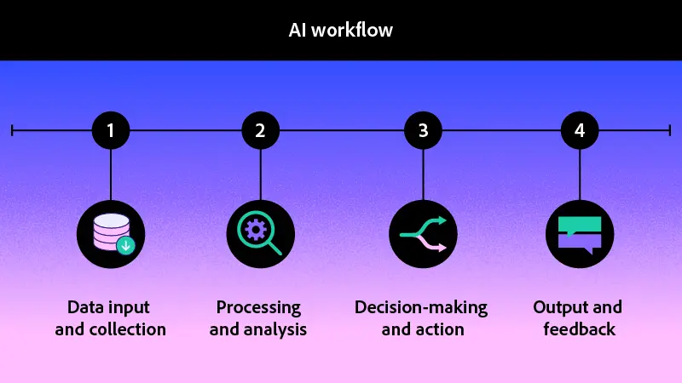
Overview of AI workflows

Slide 133
Overview of AI workflows
Problem Definition
Identify the problem that AI needs to solve.
Examples:
Predict customer churn
Detect fraudulent transactions
Identify defective products
Predict house prices
Generate test cases
2. Data Collection
Collect relevant data from sources such as:
Databases
CSV/Excel files
APIs
Application logs
Images
Text
Audio/video
Sensors
3. Data Preparation
Clean and prepare the data for AI processing.
Activities include:
Removing duplicates
Handling missing values
Correcting errors
Converting data formats
Selecting relevant features
Labeling data
4. Model Selection
Select an appropriate AI/ML model based on the problem.
Examples:
Regression → predict numerical values
Classification → predict categories
CNN → image-related tasks
Transformers/LLMs → language and generative AI tasks

Slide 134
Overview of AI workflows
5. Model Training
The model learns patterns from the available data.
Features + Labels → Training Algorithm → Trained Model
For example:
Customer data → ML model → learns patterns associated with customer churn.
6. Model Evaluation
Check whether the model performs well on unseen data.
Common metrics include:
Accuracy
Precision
Recall
F1-score
MAE
RMSE
7. Deployment
Make the trained model available to an application or users.
Application
↓
API
↓
AI Model
↓
Prediction
8. Inference
Inference is the process of using the trained model with new data.
Example:
New Customer Data
↓
Trained AI Model
↓
Churn Probability = 85%
↓
Prediction: Likely to Churn

Slide 135
Overview of AI workflows
9. Monitoring and Improvement
After deployment, continuously monitor:
Model accuracy
Response time
Data quality
Data/model drift
Bias
Security
Cost
If performance decreases, the model can be retrained or improved.

Slide 136
Overview of AI workflows
Type | Typical Workflow | Main Output
Traditional AI/ML | Data → Train → Model → Predict | Prediction/Decision
Generative AI | Prompt → Context → LLM → Generate | Text/Image/Code/etc.
Agentic AI | Goal → Plan → Tools → Actions → Observe → Adapt | Completed task/action

Slide 137
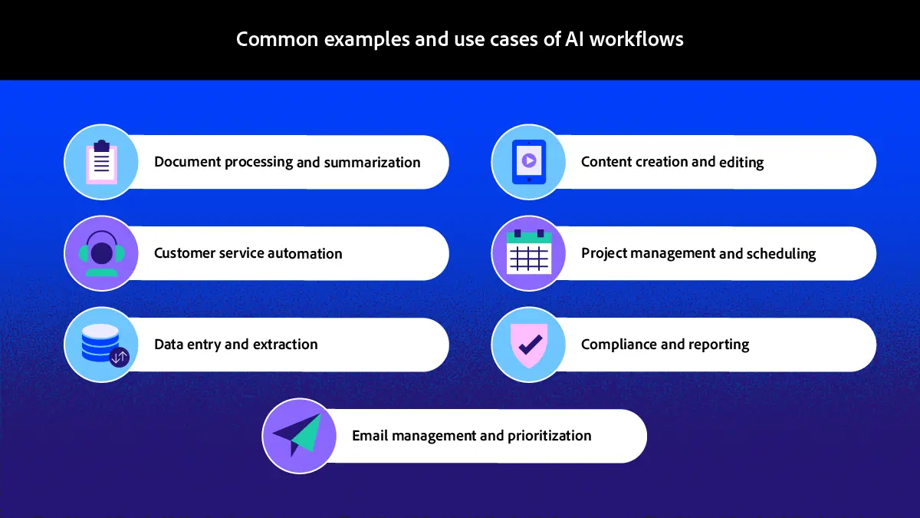
Common examples and use cases of AI workflows

Slide 138
Benefits of an AI Workflow
Increased efficiency and productivity – Automates routine tasks and accelerates complex processes.
Reduced human error – Performs tasks consistently and minimizes manual mistakes.
Cost savings – Reduces operational costs, rework, and labor-intensive activities.
Scalability – Handles increasing workloads without proportionally increasing resources.
Better decision-making – Provides data-driven insights, trends, and performance information.
Enhanced employee focus – Frees employees to concentrate on strategic and high-value tasks.
Faster turnaround times – Completes processes faster and reduces delays.

Slide 139
Thank You

